Slide 1

1910.132-138
PERSONAL PROTECTIVE EQUIPMENT

Slide 2

Objectives
Purpose of personal protective equipment (PPE)
PPE requirements
Basics of selecting PPE

Slide 3
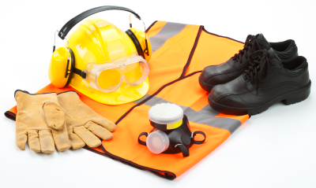
1910.132- General Requirements
(a) Protective equipment, including personal protective equipment for:
  • Eyes,
  • Face,
  • Head, and extremities,
  • Protective clothing,
  • Respiratory devices, and
  • Protective shields and barriers
  Shall be provided, used, and maintained in a sanitary and reliable condition wherever it is necessary by reason of hazards of processes or environment.

Slide 4

1910.132- General Requirements
(a) Includes:
  • Chemical hazards,
  • Radiological hazards, or
  • Mechanical irritants
Encountered in a manner capable of causing injury or impairment in the function of any part of the body through absorption, inhalation or physical contact.

Slide 5
1910.132(d)- Hazard Assessment
(1)The employer shall assess the workplace to determine if hazards are present, or are likely to be present, which necessitate the use of personal protective equipment (PPE)
If hazards are present the employer shall:
    (i)Select, and have each affected employee use, the types of PPE that will protect the affected employee from the hazards identified in the hazard assessment;

Slide 6

1910.132(d)- Hazard Assessment
(1)(ii)- Communicate selection decisions to each affected employee; and,
(1)(iii)- Select PPE that properly fits each affected employee

Slide 7
1910.132(d)- Hazard Assessment
(2)- The employer shall verify that the required workplace hazard assessment has been performed through a written certification that identifies:
  • The workplace evaluated;
  • The person certifying that the evaluation has been performed;
  • The date(s) of the hazard assessment; and,
  • Which identifies the document as a certification of hazard assessment

Slide 8
1910.132(f)- Training
(1)- The employer must train employees before issuing PPE
Each employee trained to know at least the following:
  (i)- When PPE is necessary;
  (ii)- What PPE is necessary;
  (iii)- How to properly don, doff, adjust, and wear PPE;
  (iv)- The limitations of the PPE; and,
  (v)- The proper care, maintenance, useful life and disposal of the PPE.

Slide 9
1910.132(f)- Training
(2)- Workers must demonstrate an understanding of the training and the ability to use PPE properly, before being allowed to perform work requiring the use of PPE;
(4)- Verify that each employee has received and understood the required training through a written certification that contains:
    -The name of each employee trained,
    -The date(s) of training, and that
    -Identifies the subject of the certification
    (3)- When the employer has reason to believe that any affected employee who has already been trained does not have the understanding and skill required by paragraph (f)(2) of this section, the employer shall retrain each such employee.

Slide 10

Routes of Exposure
Inhalation- Breathing it in
Absorption- Through the skin
Ingestion- Swallowing
Is there a 4th route of exposure??
Notes:
4th route of exposure- Injection

Slide 11
1910.133- Eye and Face Protection
(a)(1)- Ensure that each affected employee uses appropriate eye or face protection when exposed to eye or face hazards from:
  • Flying particles,
  • Molten metal,
  • Liquid chemicals, acids or caustic liquids,
  • Chemical gases or vapors, or potentially injurious light radiation

Slide 12
1910.133- Eye and Face Protection
(a)(2)- Ensure that each affected employee uses eye protection that provides side protection when there is a hazard from flying objects.
• Detachable side protectors (e.g. clip-on or slide-on side shields) meeting the pertinent requirements of this section are acceptable.
(a)(3)- Ensure that each employee who wears prescription lenses while engaged in operations that involve eye hazards
  • Wears eye protection that incorporates the prescription in its design, or
  • Wears eye protection that can be worn over the prescription lenses
  • Without disturbing the proper position of the prescription lenses or the protective lenses

Slide 13
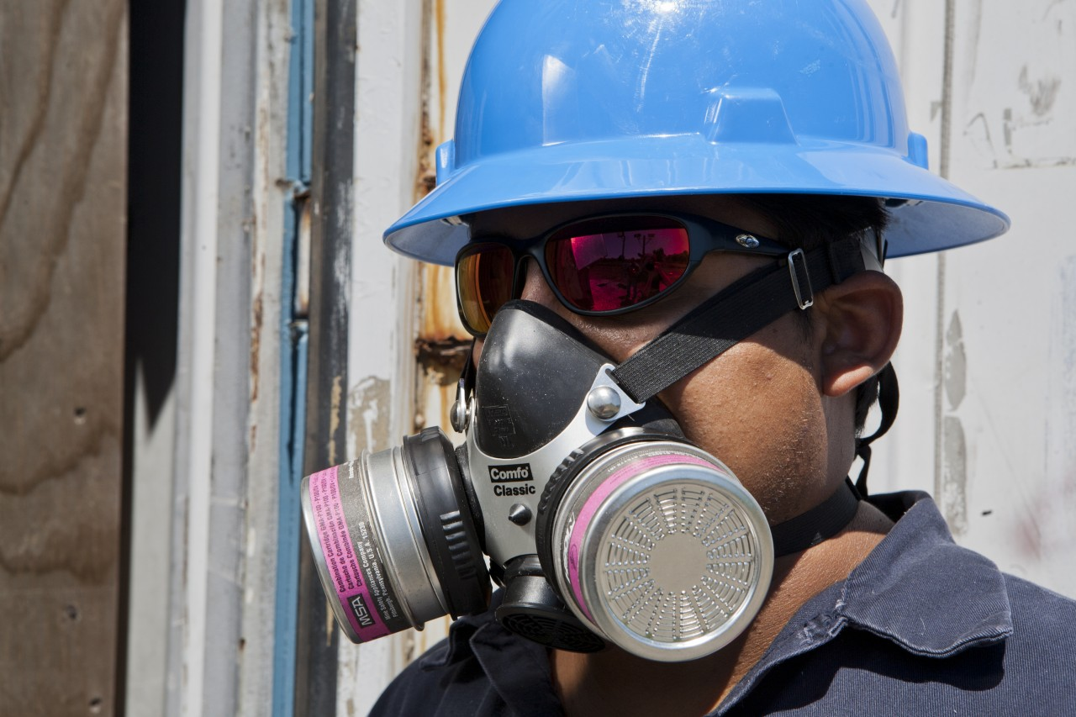
CFR 1910.134
Respiratory Protection

Slide 14
1910.134(a)(1)- Permissible practice
Workplace respiratory hazards: dusts, mists, fogs, fumes, sprays, smokes or vapors
Primary objective: Prevent atmospheric contamination
1st Priority: Engineering controls:
  • Enclosure or confinement of the operation,
  • General and local ventilation, and
  • Substitution of less toxic materials
Only where engineering controls are not feasible should respirators be used

Slide 15
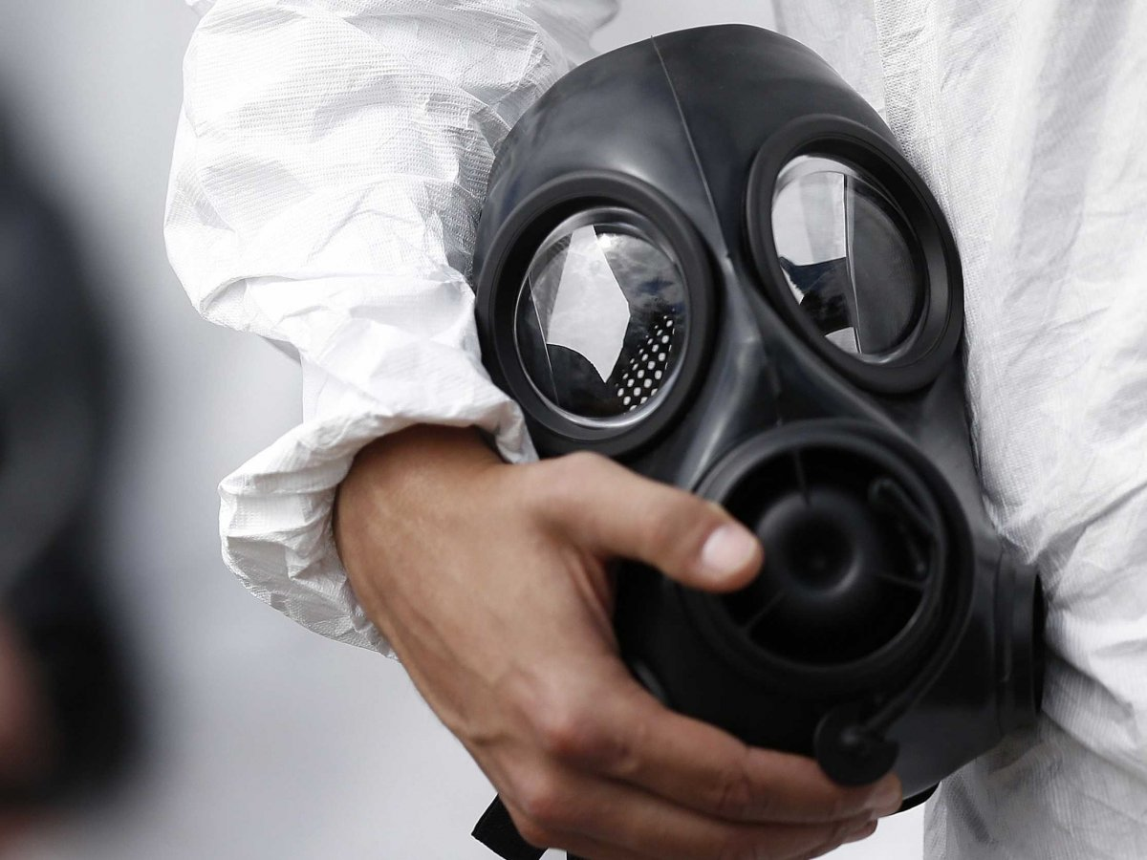
1910.134(c)(1)- Respiratory protection program
Where respirators are required you need:
  • Written program
  • Worksite-specific procedures
  Required elements:
    • Training
    • Fit testing
    • Medical evaluations
    • Care and maintenance
    • Procedures for respirator selection
    • Procedures for routine & emergency use

Slide 16
1910.134(c)(2)- Where respirator use is not required:
  (i)- If voluntary respirator use is permissible, provide the respirator users with the information contained in Appendix D and,
  (ii)- Establish and implement those elements of a written respiratory protection program* necessary to ensure that any employee using a respirator voluntarily is medically able to use that respirator.
  (ii)That the respirator is cleaned, stored, and maintained so that its use does not present a health hazard to the user.
*Written program not required for voluntary use of dust masks

Slide 17
1910.134(e)- Medical evaluations
Using a respirator may place a physiological burden on employees that varies with the type of respirator worn, the job and workplace conditions in which the respirator is used, and the medical status of the employee.
The following are minimum requirements for employee medical evaluations.

Slide 18
1910.134(e) Medical evaluations
(1)- Medical evaluations provided before:
  • Fit testing
  • Worker respirator use
(2)(i)- Identify a physician or other licensed health care professional (PLHCP) to perform medical evaluations using a medical questionnaire:
  (ii)- Obtain the information requested by the questionnaire in Sections 1 and 2, Part A of Appendix C.

Slide 19

CFR 1910.135
Head Protection

Slide 20
1910.135(a)- General requirements
(1)- Ensure that each employee wears a protective helmet when working in areas where there is a potential for injury to the head from falling objects
(2)- The employer shall ensure that a protective helmet designed to reduce electrical shock hazard is worn by each such affected employee when near exposed electrical conductors which could contact the head
Notes:
May be good for 2 to 5 years. Most of the newer ones are marked on the inside but it depends on the manufacturer.

Slide 21
Classes and Types of Hard Hats
Classes
G (old A)
General
2,200 volts
E (old B)
Electrical
20,000 volts
C (same)
Conductive
Type I hard hats - intended to reduce the force of impact resulting from a blow to the top of the head
Type II hard hats - designed to provide protection against both side impact (lateral) and blows to the top of the head

Slide 22

CFR 1910.95
Hearing Protection

Slide 23

1910.95- Noise Standard
  Action Level = 85 dBA TWA
    • Requires a hearing conservation program
    • Annual audiograms
    • Training
  PEL = 90 dBA TWA
    •Hearing protection is required

Slide 24
Types of Hearing Protectors
Earmuffs
Earplugs
Canal Caps

Slide 25

CFR 1910.136
Foot Protection

Slide 26
1910.136(a)- General requirements
Ensure that each affected employee uses protective footwear when working in areas where there is:
  • A danger of foot injuries due to falling or rolling objects, or
  • Objects piercing the sole, and
  • Where such employee's feet are exposed to electrical hazards

Slide 27

CFR 1910.138
Hand Protection

Slide 28

1910.138(a) General requirements
Employers shall select and require employees to use appropriate hand protection when employees' hands are exposed to hazards such as those from:
  • Skin absorption of harmful substances;
  • Severe cuts or lacerations;
  • Severe abrasions;
  • Punctures;
  • Chemical burns;
  • Thermal burns; and
  • Harmful temperature extremes

Slide 29
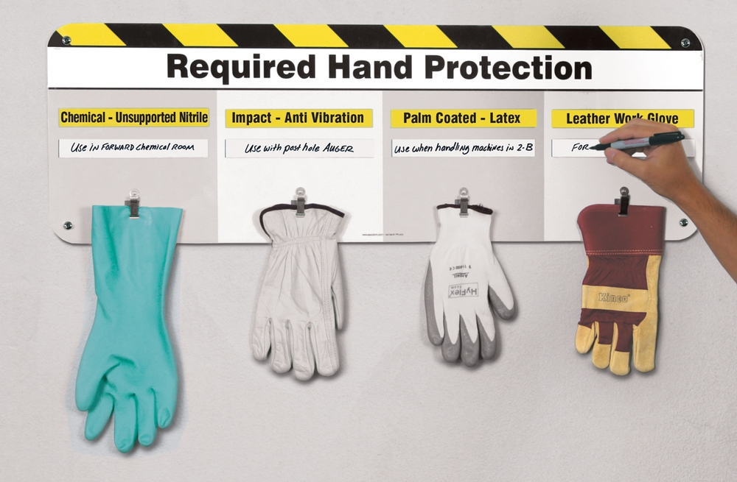
1910.138(b)- Selection
Employers shall base the selection of the appropriate hand protection on:
  • An evaluation of the performance characteristics of the hand protection relative to the task(s) to be performed,
  • Conditions present,
  • Duration of use, and;
  • The hazards and potential hazards identified

Slide 30
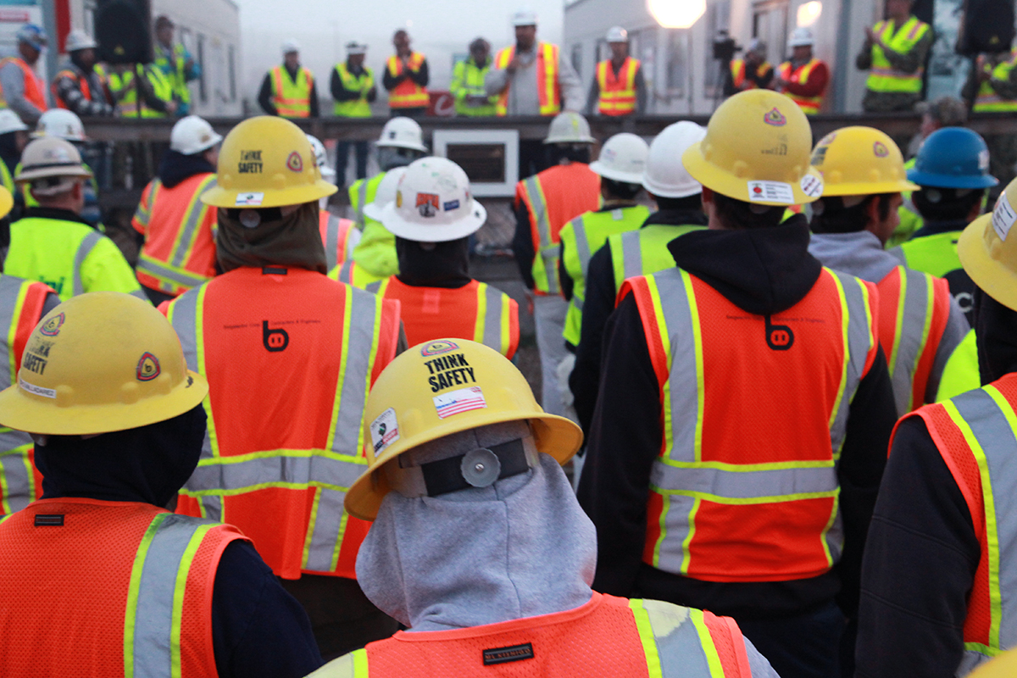
1910.132- Body protection summary
Chemical protective rain suits
Slip resistant shoes
Safety glasses
Face shield
Gloves
Hearing protection and respirators (when appropriate)

