Slide 1
Workplace Violence
has remained one of the TOP 4 causes of workplace death for
15 years
Notes:
2009-
Workplace homicide is LEADING Cause of death for women in the workplace.

Slide 2
WPV Statistics
2010:
17% of 4,609 workplace fatalities were violent acts
20 workers/week are murdered
18,000/year assaulted
2 million U.S. workers per year report being victims of some kind of workplace violence.
2012 SHRM Workplace Violence Survey, found that over 1/3rd of organizations reported incidents of WPV.

Slide 3
The Iceberg
1 Death
51, 000 rapes
84,000 robberies
396,000 aggravated assaults
1.5 million non-aggravated assaults
6.0 million threats or intimidations

Slide 4
Impacts
Direct
Indirect
Liberty Mutual Research Institute for Safety
Workplace Safety Index
2011 Annual Index reported “assaults and violent acts” as 10th leading cause of nonfatal occupational injury (2009) : $590 million WC cost
Notes:
LMRI: tracks incidence and WC costs of “the most disabling workplace injuries and illnesses” (defined as causing an ee to lose 6+ workdays).
Indirect costs: productivity, property, legal expenses, loss of public trust, reputation damage, loss of business relationships, media attention. Management attention (supervisors, HR managers/staff, senior management, medical/legal advisors). Additional law enforcement, investigations, interviews (again, taking time away from work activities).
Shareholders and public

Slide 5
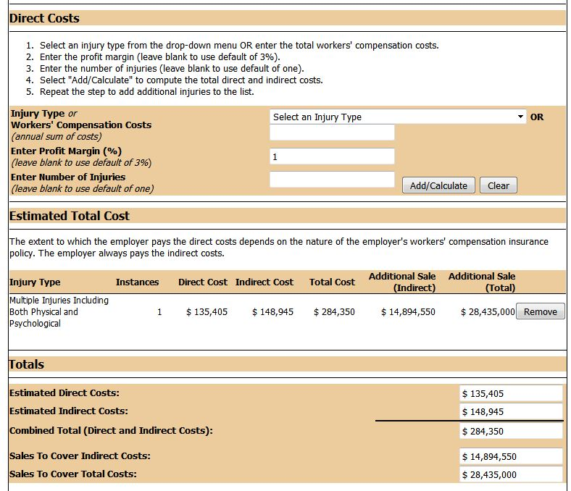
Notes:
Profit Margin of 3% = ~ $9 million combined total required to recuperate costs from one potential workplace violence incident resulting in physical and psychological injuries.

Slide 6
2013 National Safety Survey
1,000 EHS Professionals
Polled about all facets of workplace EHS
20% reported witnessing or been directly impacted by WPV:
“Physical altercation between two operators with known poor relationship”
“I have been threatened (during the first few years of my career in safety), investigated threats, and dealt with employee who was keeping a loaded firearm in his locker”
“Gang violence, death threats, physical violence between employees”
25% reported being bullied or witnessing bullying:
“Foreman tried to bully an employee into performing maintenance work without having safety protocols in place.”
Notes:
From “2013 National Safety Survey Data: EHS Today”
Forms of bullying included threats of job loss, sexual harassment (by both men and women), cursing and yelling. One person recounted an email that circulated to many people at the company that mocked an employee's surname. Another talked about a foreman who tried to bully an employee into performing maintenance work without having safety protocols in place. Another employee stepped up and intervened, possibly saving a life:
"A foreman had bullied one of his workers into crawling under a suspended tank to clean the bottom of it before they set it down. He told him if he didn't do it he would fire him. One of the other workers wrote up an observation card on it and sent it in. The worker and the foreman were called into the boss's office and the worker was reprimanded for not refusing to do an unsafe job and the foreman was fired on the spot for even suggesting that the worker would be fired for not doing the job [he had asked several other workers to do it and they had refused because it was unsafe]. The tank was then placed on some planks and braced properly and the job was done safely."

Slide 7
Classification of Perpetrators
Type | Relationship | % Workplace Homicides
Criminal Intent | No legitimate relationship to business or employees. Ex. robbery, trespassing | 85%
Customer or Client | Legitimate relationship with business. Ex. police officers, teachers, patient caregivers | 3%
Worker-on-Worker | Employee or past employee in the workplace | 7%
Personal Relationship | No relationship with business but personal relationship with intended victim who is employee. Ex. Domestic violence | 5%
Source: NIOSH “Workplace Violence Prevention Strategies and Research Needs; 2004
Notes:
NIOSH classification.
Review to determine where your highest risks could potentially be.

Slide 8
NEP: Workplace Violence
Workplace violence (WPV) is a recognized hazard in nursing and residential care facilities.
In 2010, BLS data reported approximately 2,130 assaults by persons in nursing and residential care facilities.
Is considered a “recognized hazard” by OSHA…
INSPECTIONS WILL INCLUDE:
Investigation of incidents related to workplace violence
CPL 02-01-052: Enforcement Procedures for Investigating or Inspecting Workplace Violence Incidents
Management Involvement
Worksite Analysis
Hazard Prevention and Control
Employee Involvement
Notes:
NURSING HOME SPECIFIC: The U.S. Department of Labor's Occupational Safety and Health Administration has cited ResCare Ohio Inc. for exposing employees to workplace violence at the company's Fairfield residential care facility, which operates as Camelot Lake. OSHA has proposed penalties of $8,700. Camelot Lake accumulated a total of 20 workplace violence cases from 2009-2012, resulting in 53 days away from work and 37 days of restricted duty. Employees have been exposed to physical assaults during routine interaction with residents who have a history of violent behavior.

Slide 9
Region 5 News Release: 12-819-CHI May 1, 2012 Contact: Scott Allen Rhonda Burke Phone: 312-353-6976 Email: allen.scott@dol.gov burke.rhonda@dol.gov
US Labor Department's OSHA fines Lakeview Specialty Hospital for inadequate workplace violence safeguards at Waterford, Wis., center
WATERFORD, Wis. – The U.S. Department of Labor's Occupational Safety and Health Administration has cited Lakeview Neurorehab Center Midwest, which operates as Lakeview Specialty Hospital in Waterford, for exposing employees to workplace violence at the health care facility and treatment center, among other violations. OSHA has proposed penalties of $12,000. OSHA initiated an investigation following a complaint that a worker had been severely beaten and threatened by a client at the facility on Sept. 28, 2011, as well as filed a police report with the Racine County Sheriff's Department. As a result of its investigation, which revealed that staff members at the facility had been assaulted numerous times, OSHA has cited the employer for a serious violation of the agency's "general duty clause" for failing to provide a workplace free from recognized hazards likely to cause serious injury or death. A second serious violation has been cited due to the lack of a lockout/tagout program for equipment with multiple energy sources. A serious violation occurs when there is substantial probability that death or serious physical harm could result from a hazard about which the employer knew or should have known. Additionally, OSHA has cited three other-than-serious violations involving record-keeping errors, which include a lack of entries for lost or restricted work days due to injury or illness on the OSHA 300 logs during 2011, failing to annually evaluate and inspect the energy control program, and failing to conduct annual reviews and updates of the bloodborne pathogen program. An other-than-serious violation is one that has a direct relationship to job safety and health, but probably would not cause death or serious physical harm. "These citations point to a clear and pressing need for employers operating similar facilities to develop comprehensive and effective programs that proactively address workplace violence situations imperiling the safety and health of their workers," said George Yoksas, OSHA's area director in Milwaukee. "Prevention, protection, communication and awareness training are critical to safeguarding these workers against the possibility of death or injury." Lakeview Specialty Hospital, which employs about 325 workers, consists of a long-term acute care hospital, a community-based residential facility for adults, a residential care center for children and a special education school. It is affiliated with Lakeview NeuroRehabilitation Center in Effingham, N.H. The affiliated group employs about 1,000 workers and also operates Lakeview NeuroCare in Lewistown, Pa. OSHA's "Guidelines for Preventing Workplace Violence for Health Care & Social Service Workers" resource is available online at http://www.osha.gov/Publications/OSHA3148/osha3148.html. Additional information on workplace violence is available at http://www.osha.gov/SLTC/workplaceviolence/index.html. Lakeview Specialty Hospital has 15 business days from receipt of its citations and proposed penalties to comply, meet with OSHA's area director or contest the findings before the independent Occupational Safety and Health Review Commission. To ask questions, obtain compliance assistance, file a complaint, or report workplace hospitalizations, fatalities or situations posing imminent danger to workers, the public should call OSHA's toll-free hotline at 800-321-OSHA (6742) or the agency's Milwaukee Area Office at 414-297-3315. Under the Occupational Safety and Health Act of 1970, employers are responsible for providing safe and healthful workplaces for their employees. OSHA's role is to ensure these conditions for America's working men and women by setting and enforcing standards, and providing training, education and assistance. For more information, visit http://www.osha.gov.

Slide 10
Criteria For Initiating Inspection
Known Risk Factors
Evidence of Employer and/or Industry Recognition
Feasible Abatement Methods
Notes:
OSHA Inspection focus under the Workplace Violence NEP.

Slide 11
Inspection Procedures for WPV
Request hazard assessments and incident reviews
Determine who is in charge of security
Conduct interviews to determine whether the hierarchy of controls were implemented for worker protection
Review worker training programs and methods of informing employees of the hazards and protective measures
Complete walkaround and observation
If videotaping or photographing resident handling, consent must be obtained from individual or family
Review all records (including WC, First Aid, 300’s, insurance, near misses)

Slide 12
http://www.osha.gov/SLTC/workplaceviolence/index.html
Notes:
OSHA Resources targeted directly to prevention and control of workplace violence.

Slide 13
BLS Data (2000)
In 2000, 48 %of all non-fatal injuries from occupational assaults and violent acts occurred in health care and social services.
Most of these occurred in hospitals, nursing and personal care facilities, and residential care services.
Nurses, aides, orderlies and attendants suffered the most non-fatal assaults resulting in injury.
Injury rates also reveal that health care and social service workers are at high risk of violent assault at work

Slide 14
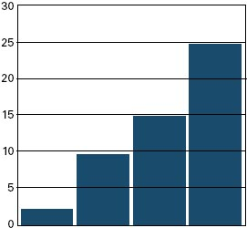
Incidence rates for nonfatal assaults and violent acts by industry, 2000 Incidence rate per 10,000 full-time workers
Private sector Healthcare Social Nursing &
overall overall Services Personal Care
Notes:
Of note – these are REPORTED incidents – but the number of assaults are actually probably much higher – many healthcare workers seem to think that some level of violence is an inherent part of the job

Slide 15
Risk Factors for Healthcare and Social Services
The prevalence of handguns and other weapons among patients, their families or friends;
The increasing use of hospitals by police and the criminal justice system for criminal holds and the care of acutely disturbed, violent individuals;
The increasing number of acute and chronic mentally ill patients being released from hospitals without follow-up care (these patients have the right to refuse medicine and can no longer be hospitalized involuntarily unless they pose an immediate threat to themselves or others);
The availability of drugs or money at hospitals, clinics and pharmacies;
unrestricted movement of the public in clinics and hospitals and
long waits in emergency or clinic areas that lead to client frustration over an inability to obtain needed services promptly;
The increasing presence of gang members, drug or alcohol abusers, trauma patients or distraught family members;
Low staffing levels during times of increased activity such as mealtimes, visiting times and when staff are transporting patients;
Isolated work with clients during examinations or treatment;
Solo work, often in remote locations with no backup or way to get assistance, such as communication devices or alarm systems (this is particularly true in high-crime settings);
Lack of staff training in recognizing and managing escalating hostile and assaultive behavior; and
Poorly lit parking areas.
Notes:
Review and determine with your staff what would be the highest risk factors for your facility.

Slide 16
Elements in a WP Violence Program
Management commitment and employee involvement;
Worksite analysis;
Hazard prevention and control;
Safety and health training; and
Recordkeeping and program evaluation

Slide 17
Workplace Violence Program
Management:
Accountability
Program development
Communication to employees
Participation in surveys
Employees:
Participation in surveys
Reporting of instances
Participating in training
Worksite Analysis:
Records review
Screening surveys
Evaluation of controls (existing or potential)
Management Commitment:
Equal commitment to safety and health of workers AND patrons/customers

Slide 18
Workplace Violence Prevention Team
Develop and Implement
Strategic Approach
Proactive vs Reactive
Human Resources
Security
Safety & Health
Legal Counsel
Employment Law
Employee Assistance Program members
Supervisors/Managers

Slide 19
On-Site Security Measures
Limited public access
Check-in or sign-in
Increased lighting
Access-card systems
ID cards
Video surveillance
Security cards
Escort service in parking lots
Metal detectors
Transportation for 2nd/3rd shift employees

Slide 20
Awareness + Action = Prevention
Prior to hiring
HR investigation
Policy (including domestic violence policy; state-specific)
Training
Managers/supervisors on early warning signs and how to address
Reporting
Employees
Reporting
Investigation
Periodic risk assessments as part of prevention policy
Communication
What is the reason for security procedures
EAP services
Practice
Emergency action plan
Facility layout/blueprints
Public info rep

Slide 21
Warning Signs
Direct or veiled threats
Harassing/bullying/ aggressive behavior
Bringing weapon to workplace or fascination with weapons
“Strange Behavior”
Troubled vs troubling
Depressed
Paranoid
Obsessive interest in job/control of job
Performance problems
Increased conflict
Increased absenteeism
Notes:
Troubled: internalized stressors and low-level behaviors; often demonstrating through performance
Troubling: escalated and externalized behaviors; disrupting the workplace

Slide 22
Risk Factors
Triggering Events
Employment terminated
Downsizing/stress
Concerns mishandled
Personality conflict
W/ Supervisor
Personal relationship
Drugs/Alcohol
Warning Signs + Risk Factors = Escalation of Threat

Slide 23
Training Resources for Workplace Violence Prevention
http://www.osha.gov/dte/library/materials_library.html#workplaceviolence
http://www.cbs.state.or.us/external/osha/educate/training/pages/120xm7.html
http://www.mincava.umn.edu/categories/943?type=1
http://www.dol.gov/ILAB/media/reports/nao/violenceworkrisk.htm
http://www.hhh.umn.edu/centers/wpp/pdf/case_studies/institutionalized_violence/case.pdf Compliance Directive: CPL 02-01-052 (effective date 9/8/11) Guidelines for Prevention: http://www.osha.gov/Publications/OSHA3148/osha3148.html

Slide 24
Additional Resources
https://web-ded.uta.edu/wconnect/CourseStatus.awp?~~13cN8004001

