Slide 1
Asbestos Awareness Training
BIE-NMNCA
Notes:
EPA requires this training within 60 days of starting to work in a building that has ACBM. OSHA requires annual refreshers. Class I, II, or III work all require more training
Training must be documented and records retained in the school’s Management Plan.
OSHA definitions:
Class I asbestos work means activities involving the removal of TSI and surfacing ACM and PACM.
Class II asbestos work means activities involving the removal of ACM which is not thermal system insulation or surfacing material. This includes, but is not limited to, the removal of asbestos-containing wallboard, floor tile and sheeting, roofing and siding shingles, and construction mastics.
Class III asbestos work means repair and maintenance operations, where “ACM”, including TSI and surfacing ACM and PACM, is likely to be disturbed.
Class IV asbestos work means maintenance and custodial activities during which employees contact but do not disturb ACM or PACM and activities to clean up dust, waste and debris resulting from Class I, II, and III activities

Slide 2
Who is required to have this training:
The Occupational Safety and Health Act (OSHA) requires all members of the maintenance and custodial staff who may work in a building that contains ACBM to complete a “asbestos awareness” course.
Custodians, electricians, heating/air conditioning engineers, plumbers, etc.
Training should be at least 2 hours.

Slide 3
Who is required to have this training:
Members of maintenance and custodial staff who conduct activities that will result in disturbance of ACBM
Training should be at least 2 hours, plus 14 hours of additional training.

Slide 4
After viewing this PowerPoint, you will know:
Where to find information on the asbestos locations at your school.
Who to report damaged asbestos to.
Who the School’s Designated Asbestos person is.

Slide 5
Where is the ACBM in your school building?
Who will you report ACBM damage to?
Where is the Asbestos Management Plan for this school?

Slide 6
THE LAW
The Asbestos Hazard Emergency Response Act (AHERA) requires:
All buildings at public schools to be inspected for asbestos.
Every School to document this inspection in an Asbestos Management Plan.
Every School to perform 6-month surveillance of asbestos containing materials.
Annual training of maintenance and custodial workers on asbestos.

Slide 7
THE LAW
A 3-year reinspection of all buildings containing asbestos.
Someone at the School to be the Designated Person.
The Designated Person to be trained in asbestos.
The School to annually notify parents, guardians, employees and temporary workers of the availability of the Asbestos Management Plan for review and any actions taken for management of the asbestos at the School.

Slide 8
Who is the Designated Asbestos Management Person for the School?
Maintenance Worker
Will I be informed of asbestos actions at the School for this past year? YES!
How? For Students - In the Student Handbook. For employees- on the staff Bulletin Board.

Slide 9
Where is the Asbestos Management Plan for your School kept?
In the School’s Main Office
Can I view the Asbestos Management Plan anytime upon request?
YES!

Slide 10
AHERA Required Topics
Asbestos background – History & Law
Asbestos’ Health Effects
Information about asbestos’ uses and forms
Locations of ACBM where you work
How to recognize damage, deterioration AND delamination of asbestos materials
Name & phone no. of AHERA Designated Person
Location & availability of Management Plan
ref: 40 C.F.R. §763.92
Notes:
Both AHERA (40 C.F.R. 763.92(a)(1)) and OSHA (29 C.F.R. 1926-1101(k)(9)(vi)) dictate what must be covered
asbestos background – can keep short unless there are questions
Health Effects – we’ll answer all your questions
Uses & forms –show’n’tell time
“locations of thermal system insulation and surfacing ACM/PACM, and asbestos-containing flooring material, or flooring material where the absence of asbestos has not yet been certified”
new respect for water damage & air erosion
know AHERA DP or point person for each building

Slide 11
What is Asbestos?
Notes:
These are not rhetorical questions.
Ask participants for their answers –everyone’s reason is valid, thank everyone but emphasize the best correct answers.
Re-phrase the questions if answers are slow in coming – eg: why are we doing this training? What can happen to people who work with asbestos?
Do you know of anyone who has or had asbestos-related illness?
Is there asbestos in this school?

Slide 12
What is Asbestos?
A “Naturally” occurring mineral.
Earlier mined in Canada and S. Africa, now China, India, Russia & Korea.
Added to building materials because of its good insulating, strength, sound-proofing, fireproofing and corrosion-resistance properties.
Notes:
Belongs to the magnesium-silicate family
Is a metamorphic rock
There are some cases of hazardous situations from native formations eg: Arizona & California
Minor production in Vermont & California
numerous old shutdown, abandoned mines and mills all over U.S.
Usage surged after WWII until health concerns emerge in 1970’s

Slide 13
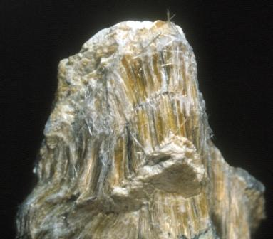
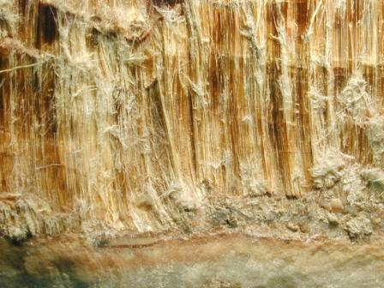
Natural Asbestos

Slide 14
What is Asbestos?
Two major classes– serpentine and amphibole
Chrysotile (white asbestos) – the only member of the serpentine class
Amosite (brown asbestos), crocidolite (blue asbestos), anthophylite, tremolite, and actinolite -- amphiboles
Notes:
Chrysotile is over 95% of commercial use
There is growing evidence that the amphibole varieties are more dangerous and likely to cause the worst diseases.
Neither class has a recognized “safe” level of exposure

Slide 15
What is Asbestos?
All types of asbestos tend to break into very tiny fibers.
Individual fibers are virtually invisible, they can only be seen using a microscope.
Some fibers may be 10,000 times smaller than a human hair.
Can remain suspended in the air for up to three days.
Notes:
Because it’s small and light, it easily spreads throughout a building through ventilation system

Slide 16
What is Asbestos?
Usually asbestos is mixed with other materials to actually form the products. Floor tiles, for example, may contain only a small percentage of asbestos.

Slide 17
The History of Asbestos
Ancient Greeks made it into cloth and named it “indestructible!”
1st century AD: Romans saw that slaves who weaved asbestos into cloth developed breathing problems.
1879: First commercial production.
1899: First documented case of Lung Scarring due to asbestos.
Notes:
for Greeks & Romans – asbestos cloth gave “magical” powers – reserved for priests, nobility
modern times – Industrial Revolution and use of steam power made asbestos almost essential
observations of asbestos diseases weren’t proof of causality.

Slide 18
History of Asbestos
1930’s: Medical journals begin publishing articles on asbestos related diseases.
1960 - 1970’s: Use of asbestos peaked.
1989: EPA banned most asbestos containing building materials (ACBMs) BUT ….
1991: The Asbestos Ban “Overturned” by Courts.
2005 : Criminal charges begin for Asbestos Deaths.
Notes:
Legislative steps to ban asbestos:
1973 – banned spray-applied surfacing ACM for fireproofing/insulating purposes
1975 – banned installation of wet-applied and pre-formed (molded) asbestos pipe insulation, and banned installation of pre-formed (molded) asbestos block insulation on boilers and hot water tanks (thermal system insulation)
1978 – banned spray-applied surfacing ACM for “decorative” purposes (“popcorn” ceiling texture)
1989 – banned, and reconfirmed in 1993
Corrugated paper
Roll board
Commercial paper
Specialty paper
Flooring felt
New uses
1990 – banned spray-on application of materials containing more than 1% asbestos to buildings structures, etc unless encapsulated in bituminous or resinous binder and materials are not friable after drying

Slide 19
Banned Asbestos Materials
EPA banned the use of the following products:
Spray-applied surfacing Asbestos Containing Materials (ACMs).
Sprayed-on application of ACMs with more than 1% asbestos to buildings, structures, pipes, and conduits - Unless the material is encapsulated with a bituminous or resinous binder during spraying and the materials are not friable after drying.

Slide 20
Banned Asbestos Materials
Wet-applied/pre-formed asbestos pipe insulation, and pre-formed asbestos block insulation on boilers /hot water tanks.
Corrugated paper, roll-board, commercial paper, specialty paper, flooring felt, and new uses of asbestos.
Materials spray-applied to buildings, structures, pipes & conduits except bituminous/resinous
Any new uses.

Slide 21
Banned Asbestos Materials
QUICK REVIEW
Spray-applied asbestos containing materials (ACMs) for fireproofing.
Wet-applied and Thermal System Insulations (TSI).
Spray-applied ACM for decoration.
Corrugated paper, roll-board, commercial paper, specialty paper.
Flooring felt.
Notes:
list adapted from CDPHE website

Slide 22
How do We Avoid ACBMs?
Does products labels state “contains asbestos?”
Not Always!

Slide 23
How do We Avoid ACBMs?
Request copy of the Material Safety Data Sheet (MSDS).
Or obtain an “Asbestos-free” Certification from distributor / manufacturer.
Use trusted brands.

Slide 24
Asbestos and Health

Slide 25
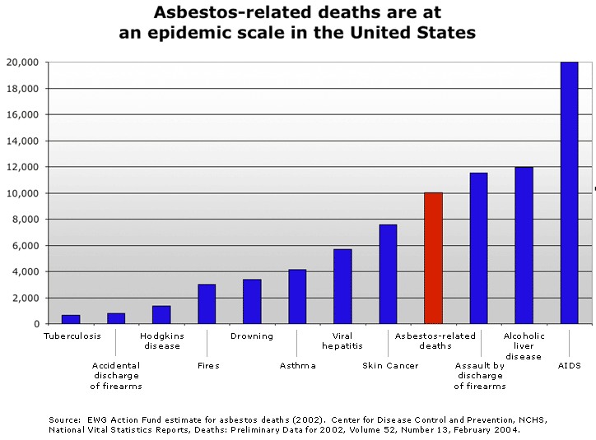
Notes:
This slide put deaths from asbestos disease in perspective with other forms of death. Underscore that it is right up there with assault by firearms and alcoholic liver disease. Feel free to compare deaths from asbestos with any of the others shown on the chart.

Slide 26
Asbestos Health Effects
Inhalation is most common and damaging pathway into the body.
Asbestos-related diseases show dose-response relationship.
Diseases are treatable but not curable.
Notes:
There is also some evidence of health damage from ingestion and skin contact but this is less common and less severe.
Most cases come from occupational exposure but asbestos-related diseases among family members and neighbors is also common.
Exposure is cumulative and disease usually progressive – death often attributed to other problems aggravated by the asbestos exposure
Individual differences play a large role, genetic factors may determine who gets which disease
there are no diagnostic tests to determine exposure after the fact until a disease develops
new evidence that other pathways are also dangerous or that migration within the body can occur eg: laryngeal cancer and ovarian cancer
Research is ongoing
CLICK ON THE BLACK BOX AFTER READING

Slide 27
Asbestos Health Effects
healthy tissue
Microscopic view of lung tissue with asbestos fibers embedded.
scar tissue
Notes:
slide from ATSDR: http://www.atsdr.cdc.gov/asbestos/asbestos/health_effects/index.html

Slide 28
Asbestos Health Effects
ASBESTOSIS: fibrotic scarring of the lungs, not a cancer.
Symptoms: shortness of breath, rales, clubbing of fingers, chest pain, loss of appetite.
Prognosis: slow, painful death; progressive & increases susceptibility to other heart/lung diseases.
Long latency: 15 to 30 years.
Common to workers with high exposure over many years.
Notes:
Reduces lung capacity – not a cancer but is progressive and incurable
Rales is a dry, crackling sound in the lungs during inhalation
Can be long period of illness with very poor quality of life
similar to silicosis (cement workers), miners’ black-lung disease (pneumoconiosis) or COPD from cigarette smoking

Slide 29
Asbestos Health Effects
Lung Cancer – many causes.
Symptoms: persistent cough, chest pain, wheezing, labored breathing.
Prognosis: slow, painful death.
Smoking increases risk 50 to 90-fold.
Long Latency: 15 to 30 years.
High levels & long term increase risk but there’s no “safe level” of exposure.
Notes:
Asbestos is just one of many causes for lung cancer
interaction with smoking is so bad that OSHA requires smoking cessation training for asbestos workers
has been seen among worker’s families and other community members without direct exposure

Slide 30
Asbestos Health Effects
Mesothelioma – rare cancer of chest lining.
Symptoms: shortness of breath, chest pain, fluid in chest cavity.
Prognosis: generally quick (1 year after diagnosis), painful death.
Long latency: 30 years or more.
Dose-response not as clear, but asbestos exposure is the leading cause (70%-80% of cases).
Notes:
only caused by asbestos or asbestos-like materials, eg: erionite
earlier treatment of removing a lung not successful
recent experimental treatment with chemotherapy has had some positive results
the only asbestos disease that lawyers will for a case

Slide 31
Asbestos Health Effects – clubbing of fingers
Notes:
this symptom is not due to asbestos fibers accumulating in the fingers but rather due to the poor blood circulation that victims have

Slide 32
Asbestos Containing Building Material (ACBM)
Only ACBM if greater than 1% asbestos
There are three main types:
Thermal System Insulation (TSI)
Surfacing Material
Miscellaneous
And two classes:
Friable
Non-friable

Slide 33
ACBM Classes
Friable: A material that, when dry, may be crumbled, pulverized or reduced to powder by hand pressure, and includes previously non-friable material after it has been damaged to the extent that it has now become friable

Slide 34
ACBM Categories
Non-Friable
Category I – packing, gaskets, resilient floor covering and asphalt roofing products
Category II – everything else, i.e., asbestos/cement products in good condition
Notes:
Why is the distinction between friable and non-friable so important?

Slide 35
Asbestos Containing Building Materials (ACBM)
Thermal System Insulation (TSI)
Pipes
Boilers
Ducts
Includes elbow and joint mudding
Can be subject to significant damage from water leaks, steam leaks, and incorrect repairs unless otherwise protected

Slide 36
ACBM – TSI – severely damaged TSI (Thermal System Insulation)

Slide 37
ACBM – TSI – cross-section

Slide 38
ACBM – TSI – Damaged pipe insulation (Boilers)

Slide 39
ACBM – TSI - block

Slide 40
ACBM – TSI – asbestos rope

Slide 41
Asbestos Containing Building Material (ACBM)
Surfacing Material
Condensation control
Acoustical insulation
Decoration
Fireproofing
Sprayed-on or troweled-on
Notes:
May be in open sight but often hidden from view as with the fireproofing on structural steel
Maybe very subject to damage unless protected
Even when in inaccessible locations, can still present hazards if in an air plenum or other area where fibers can be released into the ambient air

Slide 42
ACBM – Surfacing
Popcorn ceiling
Structural steel and deck coating
Notes:
The spray application shown is actually a non-asbestos material. Spray-on ACBM is banned but application would have appeared similar when it was still used.

Slide 43
ACBM – Surfacing
Notes:
may be extremely friable
air erosion a likely concern in some applications
beware of a drop-ceiling cavity used as return air plenum

Slide 44
Asbestos Containing Building Materials (ACBM)
Miscellaneous
Miscellaneous asbestos containing material is usually non-friable
Floor and ceiling tiles
Gaskets, mastic, plaster, wallboard
Asbestos/cement products
Fabrics such as stage curtains are not ACBM
Roofing felt, mastic and siding are not covered under AHERA
Notes:
Can’t differentiate without lab analysis

Slide 45
Miscellaneous ACBM – VAT VAT – Vinyl Asbestos Tile
non-friable
non-friable ??
Notes:
VAT = vinyl/asbestos tile or earlier asphalt/asbestos tile, the older it is the more likely that it contains asbestos. Not limited to the old 9-inch tiles.
The right side shows a cement/asbestos product used for fireproofing or heat insulation

Slide 46
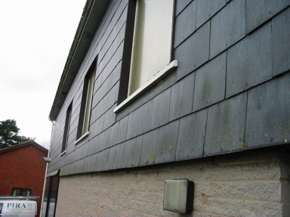
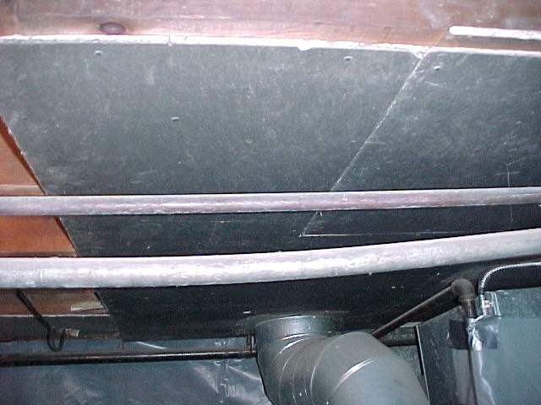
Misc. ACBM Asbestos - Cement

Slide 47
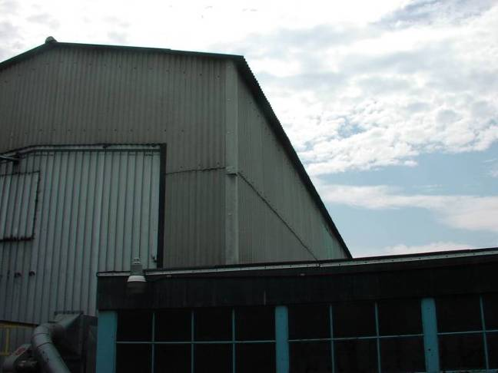
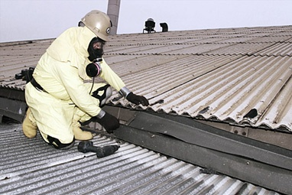
Misc. ACBM Asbestos-Cement
Asbestos Cement Board
The most commonly produced ACM worldwide today

Slide 48
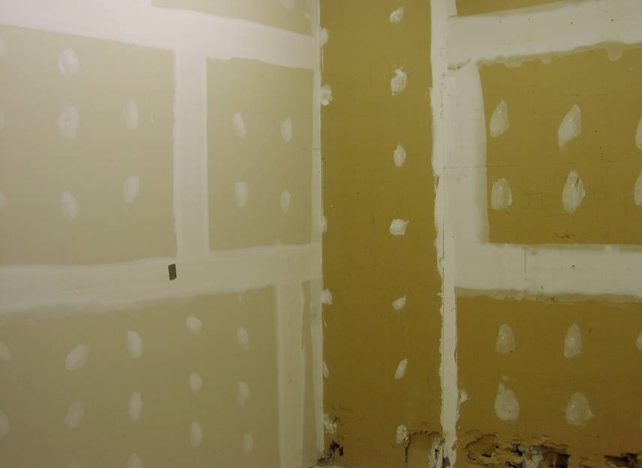
Misc. ACBM – Wallboard Systems
Notes:
Wall board, tape and joint compound are all suspect until sampled – if not sampled then it must be assumed to be ACBM.
Plaster is same situation
Asbestos-cement shingles & siding OK when in good condition – not covered under AHERA

Slide 49
ACBM - Miscellaneous
Notes:
Ceiling tiles – can only tell by sampling
Usually very friable – replacing a single 2X4 drop ceiling panel requires a certified asbestos professional
Mastic pads – often contain asbestos, usually not a hazard till matrix dries out

Slide 50
Recognizing Damage to ACBM
Look for holes, rips, water stains, abrasion.
Do not attempt to clean up loose or fallen asbestos; Contact the AHERA Designated Person.
Remember the asbestos fibers are invisible without a microscope.
Need to know where the asbestos is and always respond to any visible damage as though there has been a release.
Notes:
§

Slide 51
Asbestos Regulations
Asbestos Hazard Emergency Response Act (AHERA):
Congress passed October 1986.
EPA rules effective December 14, 1987.
Applies to all public and private schools and Local Education Agencies (LEA).
Requires inspection, management plan, training, notifications, labels, and a Designated Person.
Notes:
An inspection has to locate, sample, analyze and assess asbestos containing building materials. All suspect materials must either be sampled or assumed to be asbestos.
The management plan is compiled to determine what response actions are available to deal with the asbestos that is found. The management planner presents the alternatives to the school but the school decides how to deal with the asbestos.
The AHERA Designated Person is someone who agrees to be in charge of the execution of the plan and certifies in writing that the school is or will be in compliance.

Slide 52
Asbestos Regulations
Asbestos School Hazard Abatement Reauthorization Act (ASHARA):
Extends some of the AHERA requirements to public and commercial buildings.
Doesn’t require inspections/management plans
Does require use of accredited personnel
Increased training requirements for workers and supervisors

Slide 53
Asbestos Regulations
National Emission Standards for Hazardous Air Pollutants (NESHAP):
Requires inspection and abatement prior to renovation or demolition.
Established definitions for Category I & II non-friable ACM.
Established the “no visible emissions” standard.
Requires notification to the State when over certain threshold quantities.

Slide 54
Asbestos Regulations
OSHA Asbestos Regulations:
General industry standards cover building occupants.
Construction standards apply when working on materials containing asbestos, renovation, repair or removals.
Mandates air sampling, medical monitoring, protective equipment including respirators, safe work practices, etc. in certain circumstances.

Slide 55
Asbestos Regulations
EPA Worker Protection Rule:
Extends the OSHA standards to state and local employees who might not otherwise be covered.

Slide 56
Asbestos Regulations
Some states have adopted their own asbestos regulations or have taken responsibility for enforcing the EPA regulations.
Always check local laws.
Congress has been considering new, more comprehensive, asbestos laws – stay tuned.

Slide 57
Quiz Question #1
Asbestos training is required under:
a. The Clean Air Act
b. National Environmental Act
c. Occupational Safety and Health Act
d. The Clean Water Act
Notes:
Answer: C - Occupational Safety and Health Act

Slide 58
Quiz Question #2
Which of the following asbestos containing material products have been banned by the EPA:
a. Spray-applied asbestos containing materials (ACMs) for fireproofing.
b. Wet-applied and Thermal System Insulations (TSI).
c. Corrugated paper, roll-board, commercial paper, specialty paper.
d. All of the above
Notes:
Answer: D – All of the above

Slide 59
Quiz Question #3
Miscellaneous asbestos containing materials are usually:
a. Friable
b. Non - friable
c. Applied to boilers as insulation
d. Used as fireproofing
Notes:
Answer: B – Non-friable

Slide 60
Quiz Question #4
One of the most common uses for spray applied asbestos in a commercial building was:
a. Cooling tower fill
b. Electrical panel insulation
c. Valve packing
d. Fireproofing
Notes:
Answer: D - Fireproofing

Slide 61
Quiz Question #5
In what years was the use of asbestos as a building material most prevalent:
a. 1920 – 30’s
b. 1940 – 50’s
c. 1960 – 70’s
d. 1980 – 90’s
Notes:
Answer: C – 1960 – 70’s

Slide 62
Quiz Question #6
The primary organ that asbestos affects is the:
a. brain
b. circulatory system
c. intestines
d. lungs
Notes:
Answer: D - Lungs

Slide 63
Quiz Question #7
Friable asbestos is:
a. contained in a solid matrix of other materials
b. not regulated by OSHA or the EPA
c. easily reduced to powder by ordinary hand pressure
d. produced only in the Freeabale province of France
Notes:
Answer: C – easily reduced to powder by ordinary hand pressure

Slide 64
Quiz Question #8
Thermal system insulation can be damaged by:
a. Water leaks
b. Steam leaks
c. Incorrect or unauthorized repair procedures
d. All of the above
Notes:
Answer: D- All of the above

Slide 65
Quiz Question #9
If you find that a large amount of asbestos containing ceiling plaster has fallen to the floor in an office you should:
a. Keep people away, notify your AHERA designated person, and wait for further instructions
b. Ignore the problem and hope that nobody will notice
c. Begin a clean up procedure immediately
d. Immediately call in the HAZMAT team
Notes:
Answer: A – Keep people away, notify your AHERA designated person, and wait for further instructions.

Slide 66
Quiz Question #10
The Asbestos Hazard Emergency Response Act (AHERA) applies to all public and private schools and Local Education Agencies (LEA) and:
a. Extends the OSHA standards to state and local employees who might not otherwise be covered.
b. Requires inspection, management plan, training, notifications, labels, and a Designated Person.
c. Established the “no visible emissions” standard.
d. All of the above
Notes:
Answer: B – Requires inspection, management plan, training, notifications, labels, and a Designated Person.

Slide 67
Now, let’s review the:
Your School’s
Asbestos
Management Plan

Slide 68
QUESTIONS:
Do you know if your School has ACBMs (Asbestos Containing Building Materials)?
Who would you report ACBM damage to?
Where is the Asbestos Management Plan for this school?

Slide 69
Completion of Asbestos Awareness Training
Employee: Print Name ________________________
Sign Name _________________________ Date ___________
Please answer the following questions for your school:
Do you know if your School has ACBMs (Asbestos Containing Building Materials)?
Answer: _______________________________________________________
Who would you report ACBM damage to?
Answer: _______________________________________________________
Where is the Asbestos Management Plan for this school?
Answer: _______________________________________________________
School LEA: Print this page, retain with records, and upload to EMS website.

