Slide 1
Hazard Recognition: Watch Out for Dangers
For use in conjunction with 5-Minute Safety Talk
Notes:
Hazard Recognition: Watch Out for Dangers

Slide 2
Leading Cause
The leading cause of work related death and injury is due to contact with objects such as:
- Being struck against an object
- Struck by an object
- Caught in an object or equipment
- Caught in collapsing material
Notes:
It pays to pay attention
Today, there are always multiple things vying for your attention. However, a lack of focus on the task at hand can lead to tragedy, especially in higher risk situations.
One of the leading causes of work-related deaths is due to contact with objects, which include being struck against an object; struck by an object; caught in an object or equipment; or caught in collapsing material.

Slide 3
According to Injury Facts® 2015
In 2013 there were:
721 workplace deaths
Over 230,000 cases of injuries with days away from work
Notes:
According to Injury Facts®, there were 721 workplace deaths due to these types of incidents and more than 230,000 cases of injuries with days away from work in 2013. These types of injuries can arise from falling objects or from being inadvertently struck by a moving vehicle— such as a forklift or a car. Falls are the most common office incident, accounting for the greatest number of disabling injuries. In fact, office workers are twice as likely to suffer a fall as non-office workers.

Slide 4
Prevent Injuries…
Neatly store loose materials
Secure items that are stored at a height
Open one filing cabinet drawer at a time to prevent a tip-over
Store heavy objects close to the floor
Notes:
Paying attention to your surroundings and concentrating on the task at hand is vitally important in keeping you and your coworkers safe. Here are some tips to help prevent these injuries:
• Neatly store loose materials
• Secure items that are stored at a height
• Open one filing cabinet drawer at a time to prevent a tip-over
• Store heavy objects close to the floor

Slide 5
Prevent Injuries…
Wear the proper personal protective equipment for your environment such as steel-toed shoes
Always walk behind moving equipment if possible
Notes:
Wear the proper personal protective equipment for your environment such as steel-toed shoes
Always walk behind moving equipment if possible

Slide 6
Prevent Injuries…
Never obstruct your vision by overloading moving equipment
Only operate equipment that you are properly trained to use
Make sure all the safety devices on your equipment are in good working order before use
Use extra caution around corners, in high traffic areas and near doorways
Notes:
Never obstruct your vision by overloading moving equipment
Only operate equipment that you are properly trained to use
Make sure all the safety devices on your equipment are in good working order before use
Use extra caution around corners, in high traffic areas and near doorways

Slide 7
Speak Up for Safety
Schedule regular safety walks
Identify and report existing and potential hazards
Ensure a reporting system is in place for reporting and correcting the hazards.
Notes:
All workers should schedule regular safety walks around work areas to identify existing and potential hazards. A reporting system should be in place for reporting and correcting the hazards.

Slide 8
Witness to an Incident
Always be sure the area is safe before entering to provide First Aid
If an area is unsafe, do not enter – Instead call 911
Request that the dispatcher summon help to make the scene safe
In home environments - make sure the scene is as safe as possible Turn off the power from the main circuit breaker before helping a victim who has been in contact with electricity
Notes:
If you are witness to an incident resulting in injury:
Always be sure the area is safe before entering to provide first aid. If an area is unsafe, do not enter. Instead, call 9-1-1 to report that there are injured people in an unsafe environment and request that the dispatcher summon help to make the scene safe. In home environments, make sure the scene is as safe as possible. For example, turn off the power from the main circuit breaker before helping a victim who has been in contact with electricity.

Slide 9
Bring It Home
Take a safety walk around your home and look for potential hazards
- If you have young children, scan the areas from their perspective
Arrange furniture so there is always enough room for normal traffic
Don’t fall victim to distracted walking - especially when using your cell phone
Be present in the moment - keep your mind from wandering and concentrate on what you’re doing…even if it’s a familiar task
Notes:
Bring it home
You can take steps to make your home safer from contact with objects, too. Think about your furniture arrangement so there is always enough room for normal traffic. Don’t fall victim to distracted walking, especially when using your cell phone. Be present in the moment and try to keep your mind from wandering, even if it’s a task you’ve done a million times.

Slide 10
Who is Responsible for Safety?
Safety is everyone’s responsibility. It’s important that everyone develop an interest in following safe practices both on and off the job.
Notes:
Who is responsible for safety?
Safety is everyone’s responsibility. It’s important that everyone develop an interest in following safe practices both on and off the job and in correcting unsafe conditions.

Slide 11
Poster
Be a Safety Lookout
Spot workplace hazards and avoid incidents. Hang this poster in high traffic areas to increase hazard awareness.
Notes:
Poster
Be a Safety Lookout
Spot workplace hazards and avoid incidents. Hang this poster in high traffic areas to increase hazard awareness.

Slide 12
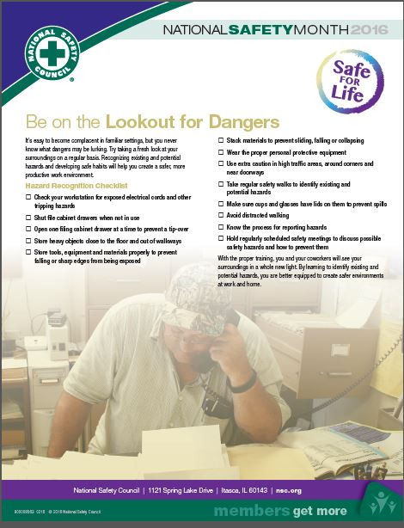
Checklist
Be On the Lookout for Dangers
Take a regular safety walk to identify potential hazards and bring this checklist to help you CHECK ON what you can do to help prevent injuries.
Notes:
Checklist…
Be On the Lookout for Dangers
Take a regular safety walk to identify potential hazards and bring this checklist to help you CHECK ON what you can do to help prevent injuries.

Slide 13
For more member-exclusive safety presentations, webinars, posters and resources visit: nsc.org/members
Customer Service – (800) 621-7619
Outside U.S. – +1-630-775-2056
Email us at:
MEMBERSHIPINFO@nsc.org
Notes:
For more member-exclusive safety presentations, webinars, posters and resources visit: nsc.org/members

Slide 14
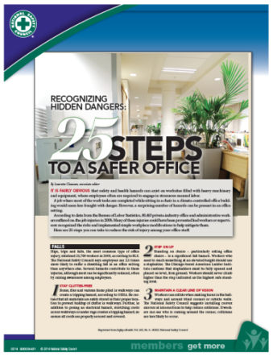
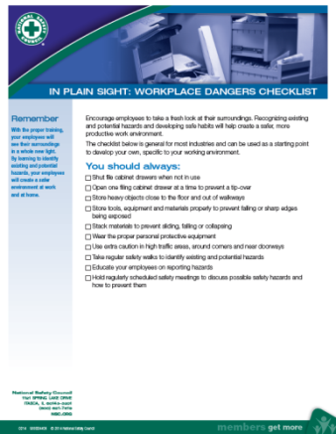
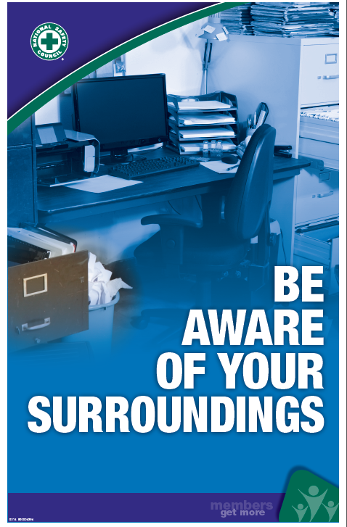
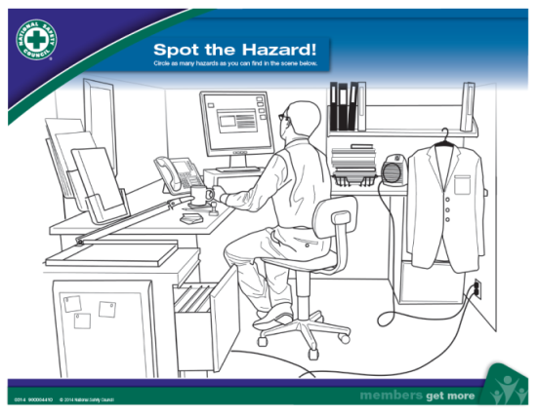
Hazard Recognition Tool Kit Resources Visit nsc.org/members
Safety+Health® Article
Checklist
Spot The Hazard Game
Poster (FPO)
Notes:
For discussion:
Questions
Observations & Concerns
Safety Action Plan

