Slide 1
Healthy Workplaces Manage Stress Managing stress and psychosocial risks at work

Slide 2
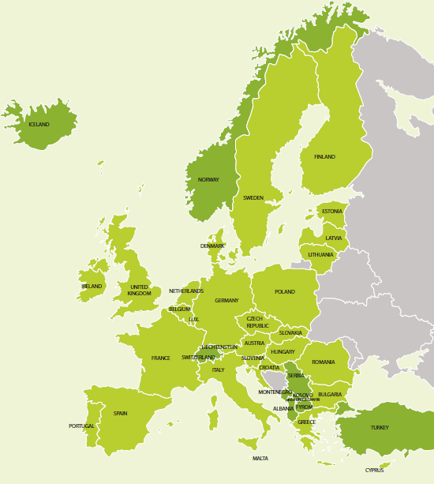
Introduction to the campaign
Coordinated by the European Agency for Safety and Health at Work (EU-OSHA)
Organised in more than 30 countries
Supported by a network of partners
National focal points
Social partners
Official campaign partners
Media partners
Enterprise Europe Network
EU institutions

Slide 3
Key objectives
Improve understanding of work-related stress and psychosocial risks
Promote management of these risks
Prevent significant negative effects
Provide support and guidance for workers and employers
Encourage the use of practical, user-friendly tools

Slide 4
The scale of the problem
Over half of European workers report that stress is common in their workplace.
Stress is thought to contribute to about half of all lost working days, along with other psychosocial risks.
Around 4 in 10 workers think that stress is not handled well in their workplace.

Slide 5
Definitions
Psychosocial risks arise from
poor work design, organisation and management;
unfavourable social context of work;
and may result in negative psychological, physical and social outcomes, including work-related stress.
Work-related stress
is an organisational issue and not an individual fault;
occurs when demands at work are beyond the worker’s capacity to cope with them.

Slide 6
The psychosocial work environment
A poor psychosocial work environment may be the result of
excessive or conflicting work demands;
lack of participation and influence over the way the job is done;
poor communication and lack of support;
psychological and sexual harassment and third-party violence;
poorly managed organisational change and job insecurity.

Slide 7
The negative effects
For the individual
Difficulty in concentrating and making mistakes
Burnout and depression
Problems in personal life
Drug and alcohol abuse
Poor physical health
For the organisation
Poor overall business performance
Increased absenteeism and presenteeism
Increased accident and injury rates

Slide 8
Managing psychosocial risks
Only about 30% of organisations in Europe have procedures in place for dealing with psychosocial risks*.
Dealing with those risks is often considered as more difficult compared to ‘traditional’ OSH risks.
But…
Psychosocial risks can be assessed and managed in the same systematic way as other OSH risks.
The benefits of managing psychosocial risks and work-related stress clearly outweigh the costs of implementation for organisations of all sizes.
* The European Survey of Enterprises on New and Emerging Risks (ESENER), European Agency for Safety and Health at Work, 2010. Available at: https://osha.europa.eu/en/publications/reports/esener1_osh_management

Slide 9
Benefits of managing psychosocial risks
Improved workers' well-being and job satisfaction
A healthy, motivated and productive workforce
Improved overall performance and productivity
Reduced absence and staff turnover rates
Reduced costs and burden on society as a whole
Compliance with legal requirements

Slide 10
The role of management
Employers are responsible for implementing a plan to prevent/reduce psychosocial risks.
Managers should promote a supportive workplace environment, encouraging workers to raise concerns and suggestions.
Middle managers have a crucial role to play as they interact with workers on a daily basis.
Good leadership and people management skills help create a good psychosocial work environment; these skills can be learned and developed.
Implementing voluntary measures to promote mental well-being can also make an important contribution to a healthy workplace.

Slide 11
The importance of worker participation
While good leadership can help to reduce work-related stress and psychosocial risks, worker participation is also key.
There must be two-way dialogue between employers and the workforce.
Workers and their representatives have the best understanding of problems in their workplace and can help to shape planning and implement solutions.
Consulting workers will help to improve overall morale and ensure that measures put in place are both appropriate and effective.

Slide 12
How to manage stress and psychosocial risks
Even with only limited resources, psychosocial risks can be effectively assessed and managed.
Being proactive and having a plan in place to pre-empt problems is the most effective way to tackle psychosocial risks in the workplace.
A risk assessment is essential to identify hazards and appropriate solutions.
Practical tools and guidance facilitating effective management of psychosocial risks are available.

Slide 13
Get involved
All organisations and individuals can take part.
Get involved by
distributing and publicising campaign messages and materials;
using and promoting the campaign’s practical tools;
taking part in campaign events or organising your own.

Slide 14
Key dates
Campaign launch: April 2014
European Weeks for Safety and Health at Work: October 2014 and 2015
European Good Practice Awards Ceremony: April 2015
Healthy Workplaces Summit: November 2015

Slide 15
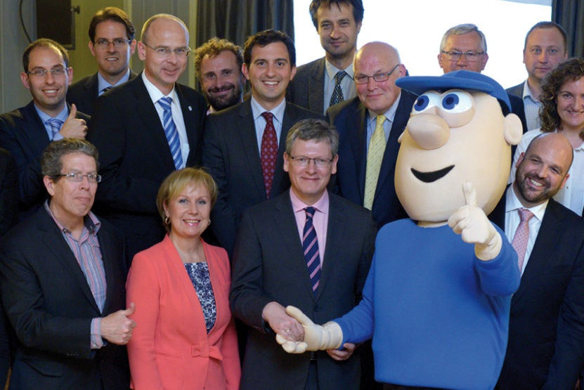
Campaign partnership offer
For pan-European and international organisations
Campaign partners promote the campaign and give it publicity.
Benefits include
a welcome pack
a partner certificate
special category for partners in the European Good Practice Awards
promotion at EU level and in the media
networking opportunities and exchange of good practice with other campaign partners
invitation to EU-OSHA events.

Slide 16
European Good Practice Awards
Recognition of outstanding and innovative good practice
Solutions towards managing stress and psychosocial risks at work
Open to organisations and enterprises
EU Member States
European Economic Area
Western Balkans and Turkey
Entries coordinated by focal points and EU-OSHA in two stages:
Selection procedure at national level
European level evaluation
Good Practice Award Ceremony

Slide 17
Campaign resources
Campaign Guide
Leaflet
Good Practice Awards Flyer
Online Campaign Toolkit
Promotion material and give-aways
Reports
Practical guides and tools
Napo film
www.healthy-workplaces.eu

Slide 18
Further information
Learn more from the campaign website
www.healthy-workplaces.eu
Campaign toolkit
https://osha.europa.eu/en/campaign-toolkit
Find out about events in your country from your local focal point
www.healthy-workplaces.eu/fops

