Slide 1
Risk Assessment & Safety Management Model (RASM) ©
Managing Program Safety through Active Leadership
Rick Curtis www.OutdoorEd.com Princeton University Outdoor Action Program
Copyright © Rick Curtis 2009
Notes:
Hello my name is Rick Curtis. I’m the director of the Outdoor Action Program at Princeton University and the author of The Backpacker’s Field Manual published by Random House. I’m also the founder of OutdoorEd.com. This presentation is on the Risk Assessment and Safety Management model or RASM. This model is designed to provide your organization and your staff with a real-world tool to help you prepare for risk, analyze risk in the field, and help reduce it. I hope that you find this information helpful the overall risk management plan for your organization.
Like most models, this model is indebted to the work that came before. I’m particularly indebted to Alan Hale whose Dynamics of Accidents Model was my first exposure to the causes of accidents. Others who paved the way before me include Cathy Haddock from the New Zealand Mountain Safety Council for her book Managing Risks in Outdoor Activities and the Accident Matrix© developed by Dan Meyer and refined by Jed Williamson and for the Accident Matrix.
All of these models addressed a part of how accidents happen but I didn’t find that they any of them told the whole story, so I developed the Risk Assessment and Safety Management Model (RASM). I hope that you find it a useful approach to risk management for your program.

Slide 2
Creative Commons License
This presentation is copyrighted by Rick Curtis and is made available under the Creative Commons 3.0 License. The information below must be included in all usage/display of this copyrighted work.
You are free:
to Share — to copy, distribute, display, and perform the work
to Remix — to make derivative works
Under the following conditions:
Attribution. You must attribute the work in the manner specified below under Attribution Statement.
Noncommercial. You may not use this work or any derivative work for commercial purposes. Individuals or organizations wishing to use this material for commercial purposes may purchase a license. Contact rcurtis@alumni.princeton.edu for details.
Share Alike. If you alter, transform, or build upon this work, you may distribute the resulting work only under the same license to this one.
Apart from the remix rights granted under this license, nothing in this license impairs or restricts the original author's rights.
Attribution Statement (must be included in all works):
The Risk Assessment & Safety Management Model is the creation of Rick Curtis, Director of the Outdoor Action Program at Princeton University and the founder of OutdoorEd.com.
Notes:
This presentation and associated materials is being released under the Creative Commons 3.0 license. This material is copyrighted by Rick Curtis. It may be used under the following conditions. This slide must be shown whenever this presentation is given.
The information below must be included in all usage/display of this copyrighted work.
You are free:
to Share — to copy, distribute, display, and perform the work
to Remix — to make derivative works
Under the following conditions:
Attribution. You must attribute the work in the manner specified by the author or licensor (but not in any way that suggests that they endorse you or your use of the work).
Noncommercial. You may not use this work for commercial purposes.
Share Alike. If you alter, transform, or build upon this work, you may distribute the resulting work only under the same or similar license to this one.
Apart from the remix rights granted under this license, nothing in this license impairs or restricts the author's rights.
Attribution Statement (must be included in all works):
The Risk Assessment & Safety Management Model is the creation of Rick Curtis Director of the Outdoor Action Program at Princeton University and the founder of OutdoorEd.com.

Slide 3
Presenter Preparation
Review the presentation and be comfortable with the concepts. I’ve included detailed presenters notes for each slide to illustrate how I give this presentation.
Make this as interactive as you can. Question your audience. Ask them to brainstorm.
Have true stories of your program or other programs to illustrate the major points. Sprinkle these throughout your presentation. Storytelling is the best way to cement these concepts.
I’ve found that the two clips from the movie Cast Away are particularly helpful for illustrating points and for keeping the audience actively engaged and thinking. Details on the clips are included in the slides.
Notes:
Here are some examples of stories:
Into Thin Air – this book relates the 1996 deaths on Mount Everest. This is a great example of Environmental, Equipment and People Hazards resulting in deaths and injuries.
The Challenger Disaster – Another example of Environmental Hazards (cold temperature at launch), Equipment Hazards (O-rings that weren’t designed to handle cold temperatures) and People Hazards (NASA managers decision to launch even after being warned about the O-rings).

Slide 4
Start Presentation

Slide 5
Risk Assessment & Safety Management Model (RASM) ©
Managing Program Safety through Active Leadership
Rick Curtis www.OutdoorEd.com Princeton University Outdoor Action Program
Copyright © Rick Curtis 2009
Notes:
Hello my name is Rick Curtis. I’m the director of the Outdoor Action Program at Princeton University and the author of The Backpacker’s Field Manual published by Random House. I’m also the founder of OutdoorEd.com. This presentation is on the Risk Assessment and Safety Management model or RASM. This model is designed to provide your organization and your staff with a real-world tool to help you prepare for risk, analyze risk in the field, and help reduce it. I hope that you find this information helpful the overall risk management plan for your organization.
Like most models, this model is indebted to the work that came before. I’m particularly indebted to Alan Hale whose Dynamics of Accidents Model was my first exposure to the causes of accidents. Others who paved the way before me include Cathy Haddock from the New Zealand Mountain Safety Council for her book Managing Risks in Outdoor Activities and the Accident Matrix© developed by Dan Meyer and refined by Jed Williamson and for the Accident Matrix.
All of these models addressed a part of how accidents happen but I didn’t find that they any of them told the whole story, so I developed the Risk Assessment and Safety Management Model (RASM). I hope that you find it a useful approach to risk management for your program.

Slide 6
Attribution Information
The Risk Assessment & Safety Management Model is the creation of Rick Curtis, Director of the Outdoor Action Program at Princeton University and the founder of OutdoorEd.com.
It is released for non-commercial, share-alike use under the Commercial Commons 3.0 license. For more information see www.outdoored.com/Community/wikis/articles/risk-assessment-and-safety-management-model-commercial-license.aspx

Slide 7
How do we Manage Risk?
The Risk Assessment & Safety Management Model (RASM) takes into account the negative causation factors (Hazards) of other models
It also adds in positive Safety Factors which interact dynamically with the Hazard Factors to alter the Risk Level
Managing risk can be by both reducing Hazard Factors and/or adding Safety Factors
Notes:
The Risk Assessment and Safety Management model (RASM) takes into account the negative causation factors or hazards of previous models but it also adds in positive safety factors which interact dynamically with a hazard factors to alter the risk level. That means that managing risk can be accomplished by both reducing hazard factors and also by adding safety factors in the equation, something the earlier models didn’t focus on.

Slide 8
Objectives
Define Risk
Identify the major causal factors in accidents/near misses
Explore a model for managing risk that incorporates the major causal factors
Identify best practices for assessing and managing risk before an event
Identify procedures for evaluating risk and mitigating it in the field
Notes:
The objectives of this presentation are to:
Define Risk
Identify the major causal factors in accidents/near misses
Explore a model for managing risk that incorporates the major causal factors
Identify best practices for assessing and managing risk before an event
Identify procedures for evaluating risk and mitigating it in the field

Slide 9
Definitions of Risk
The probability that something will cause injury or harm
A venture undertaken without regard to possible loss or injury
Exposure to chance of loss or damage
The potential for losing something of value
Any uncertainty about a future event that threatens your organization’s ability to accomplish its mission (Insurance industry)
Potential of gaining something of value (Finance)
Notes:
First let us take a look at some of the definitions of the word Risk.
The probability that something will cause injury or harm
A venture undertaken without regard to possible loss or injury
Exposure to chance of loss or damage
The potential for losing something of value
The insurance industry defines risk as any uncertainty about a future event that threatens your organization’s ability to a complete its mission.
In the finance industry risk is defined as the potential of losing something of value but also the potential for gaining something of value.

Slide 10
Defining Risk
-R: Negative Risk is the potential for loss, injury, illness
+R: Positive Risk is the potential for gain, growth, development
Notes:
In this model there are two different types of risk the first is what I call Negative R(isk) or Negative R. Negative R is the potential for loss injury or illness which is what we typically associate with accidents in the field. Positive R(isk) or Positive R is the potential for gain growth and development. So in all of our programs, we have both Negative R and Positive R.
We all know about the negative model of risk, what is the positive side of risk in our industry? Risk is an underlying principal in all of outdoor and adventure education. The fundamental philosophical principles of Kurt Hahn and others is that the exposure to risk/challenge is what impels people to personal growth.
Each program has to evaluate the level of Negative R that is appropriate for your organization's mission. For example, in my work running wilderness orientation programs for incoming college freshmen, the level of Negative R that is appropriate to accomplish our mission is low. However, if I am working in a therapeutic program with serious drug offenders, the consequences for them not getting off drugs have huge Negative R so I would tolerate running a program that might have a higher Negative R in order to influence behavior change.

Slide 11
Risk is…
Inherent: -R: exists in outdoor adventure activities
Expected: -R can occur at any time – expect the unexpected
Manufactured: we plan programs with the understanding that there is -R.
Integral: -R and +R are essential parts of our program
Notes:
So risk is inherent in our programs. That is Negative R exists in all adventure activities. Risk is expected. Negative R can occur at any time so we have to expect the unexpected. Risk is manufactured. We plan programs with the understanding that there is some Negative R. In fact our programs wouldn't function without some level of Negative R. And finally risk is integral. Both Negative R and Positive R are essential parts of our programs.

Slide 12
Risk Formula
Risk Equation for an Accident Probability that something will happen x Severity if it does = Risk Level
Prob x Sev = Risk
Notes:
The Level of Risk is determined by the following formula:
Frequency/Probability * Severity = Risk Level
The Risk Level is the Frequency or Probability that an incident will occur times the potential Severity of the incident if it occurs.

Slide 13
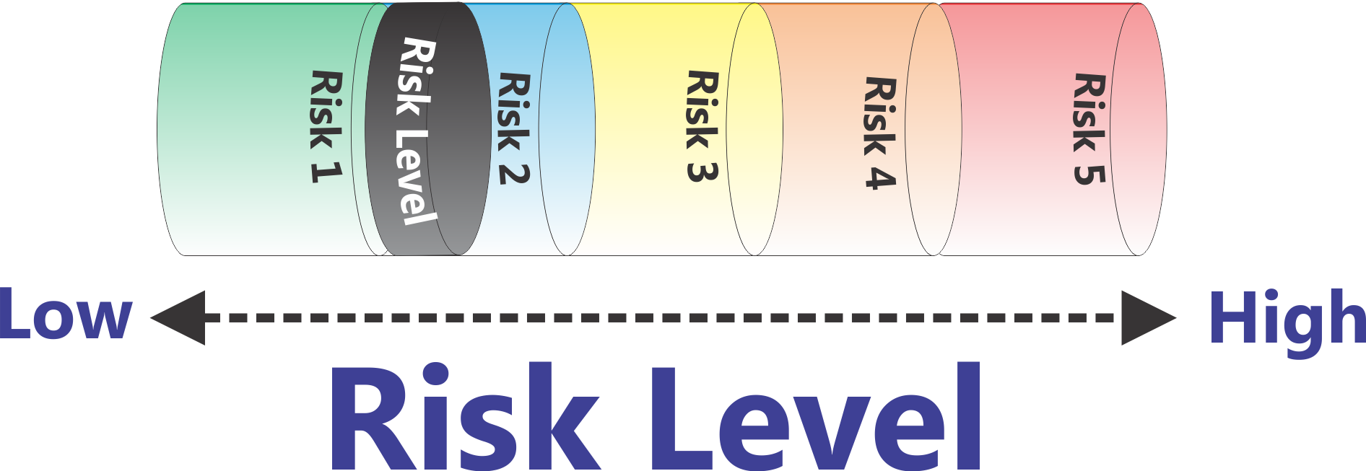
Acceptable Risk Level
Notes:
Here is a representation of increasing Risk Levels. As the Risk goes up (Frequency/Probability * Severity) then the piston goes up.
In this particular demonstration of the RASM model we are arbitrarily setting the risk level with a scale of one to five. What risk scale you actually use is up to you. This five point scale is based on the U.S. Department of Homeland Security Threat (Risk) Advisory level. (Low - Green, Guarded - Blue, Elevated - Yellow, High – Orange, Severe – Red)
Can the risk level ever be zero? No, there is no such thing as a risk level of zero. Whenever we send out a trip or run a program there is some level of risk. The question is to determine at an organizational level what level of risk you are comfortable operating your program at.

Slide 14
Accident Iceberg
The Accident Ratio Study
Tip of the Iceberg
Serious or Major Injury: Includes disabling and serious injuries
1
Minor Injury: Any reported injury less than serious
10
Property Damage: All types
30
600
Incidents With No Visible Injury or Damage: Near accidents or close calls
Accident Ratio Study (Bird & Germaine, 1989)
Notes:
The Accident Ratio is based on research done by Bird and Germain in 1992 looking at industrial accidents which identified that for every serious injury there were 10 cases of minor injury, 30 cases of property damage and 600 of what we would call near misses of close calls. For example, for every serious injury in a factor (say someone’s hand cut off in a stamping machine, there would be 10 minor injuries, 30 cases of property damage and 600 instances where (for example) someone almost got their hand cut off in a stamping machine.
We can apply this same perspective to accidents in the outdoor industry. This is often called the “accident iceberg” because the thing that we focus on, the serious injury, happens rarely. If we only look at those small number of serious incidents we aren’t seeing the full picture—we are missing what lies ‘beneath the surface.’
For that one time that a backpacking stove flares up and actually burns someone, there are many cases where stoves flared up and people jumped out of the way. If you only look at the incident where someone gets burned (or you ignore it because it hasn’t happened in your program) you are missing the big picture of what could be waiting to happen.

Slide 15
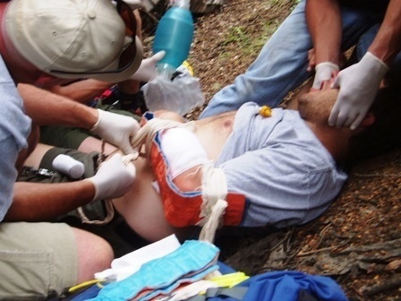
Why do Accidents Happen?
Notes:
This is the kind of situation that we want to prevent. So why do accidents happen?

Slide 16
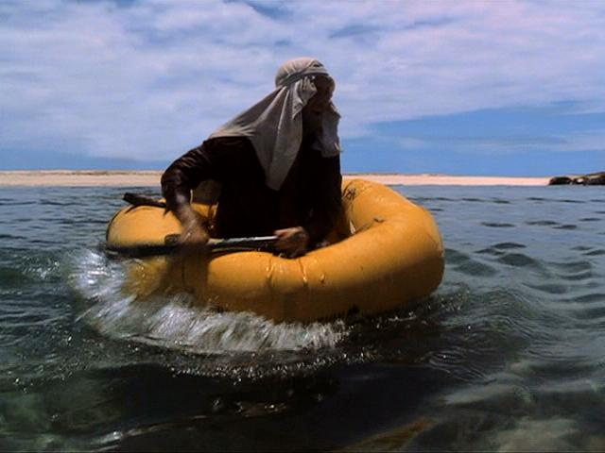
An Accident in the making…
Cast Away Scene 1
DVD Chapter 14
Notes:
What we are going to do now is watch an accident unfold in front of our eyes. We are going to watch a clip from the movie Cast Away with Tom Hanks. How many people have seen Cast Away? If you haven’t see it here is a quick synopsis of the film:
Tom Hanks plays Chuck Noland, a Federal Express Systems analyst who travels the world setting up and reviewing Fed-Ex shipping centers. He is called away for work while at a holiday gathering with relatives. He boards a Feb-Ex cargo plane with a small flight crew. While flying through a violent thunderstorm somewhere over the southern Pacific Ocean, the FedEx cargo jet crashes into the ocean in flames and all of the flight crew are killed. Saved by an inflatable life-raft, Chuck floats helplessly on the ocean until he is washed up on a deserted island, the lone survivor.
His first night on the island Chuck wakes up to go to the bathroom and sees the light of a ship on the horizon. At first light he takes the partially inflated rafted and paddles out towards the ship.
Instruct the class that they are going to see an accident unfold before their eyes. Their job is to look for what the precipitating causes of the accident are.
Show Chapter 14 of the DVD (starting around minute 54:00) from him starting to paddle out in the raft through when he comes up for air after having cut his thigh on the coral reef.
After watching the clip and before moving to the next slide, ask the class what they saw as causal factors. Write it up on the board. As you do, place each causal factor in one of the following columns: Environmental Causes, Equipment Causes, People Causes. Do not label these categories initially. Once the class has come up with the causes, ask them if they can create a category name for how you have placed the items on the board. You may want to coach them on some of the less obvious ones – like his indecision about paddling into the waves—he stops paddling, looks back and land, out at the waves, back at land—frozen in indecision.
Define these categories as the Hazard Factors that contributed to the accident.

Slide 17
Hazard Factors
Equipment
Environment
People
No Food Water
Fear / Anxiety
Paddle
Huge Waves
Indecisive
Raft
Coral Reef
No Plan
Notes:
This slide will let you walk through the major hazards that were identified in the class discussion about Tom Hank’s accident. Remind people about the concept of a “Close Call.” For example, ask them what would have happened if Tom Hanks had landed a foot away from the coral reef? This would be a near miss. All of the hazards were still present, he just ended up missing the accident by just 12 inches.
You can also ask them to brainstorm the extended consequences of Tom’s accident. For example, he is in a remote location. His leg could get infected. Also some corals carry toxins so he could be poisoned.
Bring up the idea that the Equipment and Environmental Hazards are typically ‘objective’ things—things you can see, feel, etc. This makes them easier to identify. The People hazards are often much harder to identify. They are often ‘subjective’ things like feelings, attitudes, decision-making, etc.
Talk about the idea of fear/anxiety as one example. I ask if anyone skis or snowboards (if not ask them to relate it to another activity they do). I ask if anyone has ever gotten onto a trail and then realize they have made a big mistake. They are skiing something way too difficult (most will raise their hands). I talk about my experience as a Telemark skiier. How sometimes being on a difficult slope will get my adrenaline going, I’ll really focus and by taking it a piece at a time, I’ll get down. I relate how I’ve also gotten onto slopes that were so hard and I was so scared that my completely technique fell apart. Now I am really losing control of my skis and that makes me even more scared. Let people know that fear/anxiety is one of these things that can be invisible and can escalate suddenly increasing the risk level significantly.
I introduce the idea of ‘leader’s radar’ as one of the responsibilities of being a leader. One of the things you are looking for with your ‘radar’ is potential hazard factors.

Slide 18
Hazard Factors
Notes:
I think of each hazard factor as a ball that is added in to one of the three containers—Equipment Hazards, Environmental Hazards, and People Hazards. The actual “balls” that you put into the model are going to be dependent on the types of activities you are doing, your location, etc. For example, the hazard factors for rock climbing will be different than those for whitewater kayaking.
Let's take a look at the next stage of the model that will show how these factors all interact to create a dynamic risk level.

Slide 19
Risk Assessment & Safety Management Model (RASM) ©
Notes:
So let's take a look at the overall risk assessment and safety management model in the following graphic. What you see here can be thought of as a simple balance scale. If we look on the left side we see a series of hazard factors that fall into three categories: Environmental Hazards, Equipment Hazards, and People Hazards. In the center we see risk levels. As Hazard Factors accumulate on the left-hand side of balance scale, here shown as adding balls into the cylinders, the piston in the Risk Level cylinder will go up. Increasing the risk level doesn’t mean that you are going to have an accident, just that the potential for having an accident is increasing.
This is a place to remind people of the Risk Formula:
Frequency/Probability * Severity = Risk Level

Slide 20
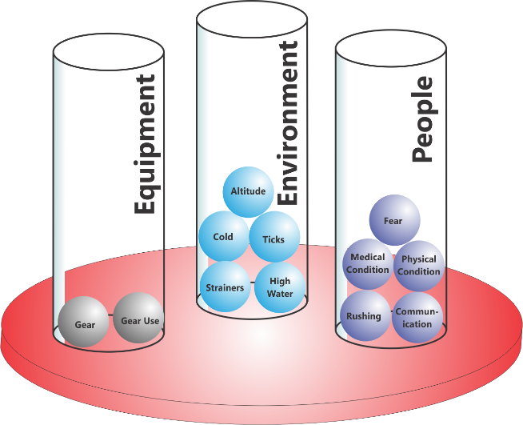
Hazard Factors
Equipment Hazards | Environmental Hazards | People Hazards
Improper gear Small paddle Under-inflated raft No food or water | Huge breaking waves Coral reef | Indecisive No plan Fear/Anxiety
Notes:
Here’s an overview of the Tom Hanks accident.
In order to manage risk you need to systematically look for and assess the potential Hazard Factors. Before a trip goes out you want to make a list of the types of things that could be hazards. During the trip you want to be constantly looking for Hazard Factors.

Slide 21
Hazard Factors
Environment
High Water
Cold Temperatures
Lightning
Equipment
Improper gear
Broken stove
People
People
Asthma
Poor Communication
Fear/Anxiety
Notes:
The actual “balls” that you put into the model are going to be dependent on the types of activities you are doing, your location, etc. Here are some examples of factors (balls) in the Environment, Equipment, and People Hazard categories.
If you want to get more detailed about this you can have the group brainstorm examples of the different categories of Hazard Factors. You can also break the People Factors into different populations (people hazards for everyone in the group, people hazards for participants, people hazards for leaders, and people hazards for the entire group). There are some slides of this in the appendix.

Slide 22
Factors which influence the types of Hazards
Location
Close to resources
Remote
Activity
Static
Hiking
Dynamic
Whitewater Kayaking
Season
Climate
Weather
Notes:
There are a number of factors that have an influence on the types of hazards one can experience.
Location has an impact on the potential severity level on an incident. When you are close to resources, the ability to respond to an incident can be greater with a shorter response time. In a remote location getting help may be difficult and time consuming.
The particular Activity that you are engaged in is an important factor. The Hazard Factors on a summer backpacking trip are very different from the Hazard Factors on a winter backcountry skiing trip. Also, the Environment related to the activity can be either Static or Dynamic. A Static Environment is one that changes on a time line that is observable. For example on a summer backpacking trip weather can change but it changes over time and you can observer that the weather is deteriorating with enough time to take action. A Dynamic Environment is something that changes over a much faster time period and often can’t be anticipated. For example, suddenly having a slope avalanche beneath you on a backcountry skiing trip is a Dynamic Environment. Of course Dynamic Environments add additional hazard.
Finally Season has a significant impact which includes the general climate for that location at that time of year and also includes local weather variations that can take place.

Slide 23
Hazard Impact
Analyzing the actual Hazard is essential in determining the extent to which it is a large or small factor.
Potential Consequences of High Altitude
Mild Altitude Sickness
High Altitude Pulmonary Edema (HAPE)
High Altitude Cerebral Edema (HACE)
High Altitude
Notes:
‘Not All Balls are the Same Size’
Calculating the impact of risk is more than just identifying the particular hazard. It’s also important to recognize that some hazards have more impact than others. One formula that is used for calculating the individual risk is
RISK = FREQUENCY OF OCCURENCE * SEVERITY OF OUTCOME
Let’s take the example of High Altitude. There are a number of illnesses associated with High Altitude.
Mild Altitude Sickness
High Altitude Pulmonary Edema (HAPE)
High Altitude Cerebral Edema (HACE)

Slide 24
Hazard Impact = ‘Ball Size’
10,000 feet/3,048 meters
Mild Altitude Sickness Frequency High * Severity Moderate = Moderate Risk (10)
High Altitude Pulmonary Edema (HAPE) Frequency Low * Severity High = Low Risk (5)
High Altitude Cerebral Edema (HACE) Frequency Very High * Severity High = Low Risk (1)
High Altitude
Risk Level = 12 (arbitrary)
Notes:
Let’s see what the impact of this particular Hazard Factor will be at 10,000 feet (3,048 meters). For this example the actual numbers are not based on any real scale (or the 1-5 scale) but merely serve to illustrate the point.
At 10,000 feet the chance of Mild Altitude Sickness is moderate but the severity at this altitude is low so we’ll give it a total value of
Frequency Moderate (5) * Severity Low (2) = Moderate Risk (10)
High Altitude Pulmonary Edema (HAPE) is Frequency Very Low (0.1) * Severity High (10) = Low Risk (1)
High Altitude Cerebral Edema (HACE) is Frequency Very Low(0.1) * Severity High (10) = Low Risk (1)

Slide 25
Hazard Impact = ‘Ball Size’
18,000 feet/5,486 meters
Mild Altitude Sickness Frequency Very High * Severity Moderate = Moderate Risk (20)
High Altitude Pulmonary Edema (HAPE) Frequency High * Severity High = High Risk (50)
High Altitude Cerebral Edema (HACE) Frequency High * Severity High = High Risk (50)
High Altitude (12)
High Altitude
Risk Level = 120 (arbitrary)
Notes:
At high altitudes the Frequency of these illnesses is fairly high and the Severity is high. If we assign some numbers to these we get a Risk Level of 12, a very large ‘ball.’
At 18,000 feet the occurrence of
Mild Altitude Sickness is
Frequency Very High (10) * Severity Low (2) = Moderate Risk (20)
High Altitude Pulmonary Edema (HAPE) is
Frequency Moderate (5) * Severity High (10) = High Risk (50)
High Altitude Cerebral Edema (HACE) is
Frequency Moderate (5) * Severity High (10) = Low Risk (50)

Slide 26
Reduce the Risk Level
How Do You Reduce the Risk Level?
Remove or Reduce all the Hazards you can
What if that’s not Enough?
Notes:
Ask the class how they can reduce the Risk Level. We’ll continue to build on this slide as we go through the presentation.
To Reduce the Risk Level
1. Remove or Reduce all the Hazards you can

Slide 27
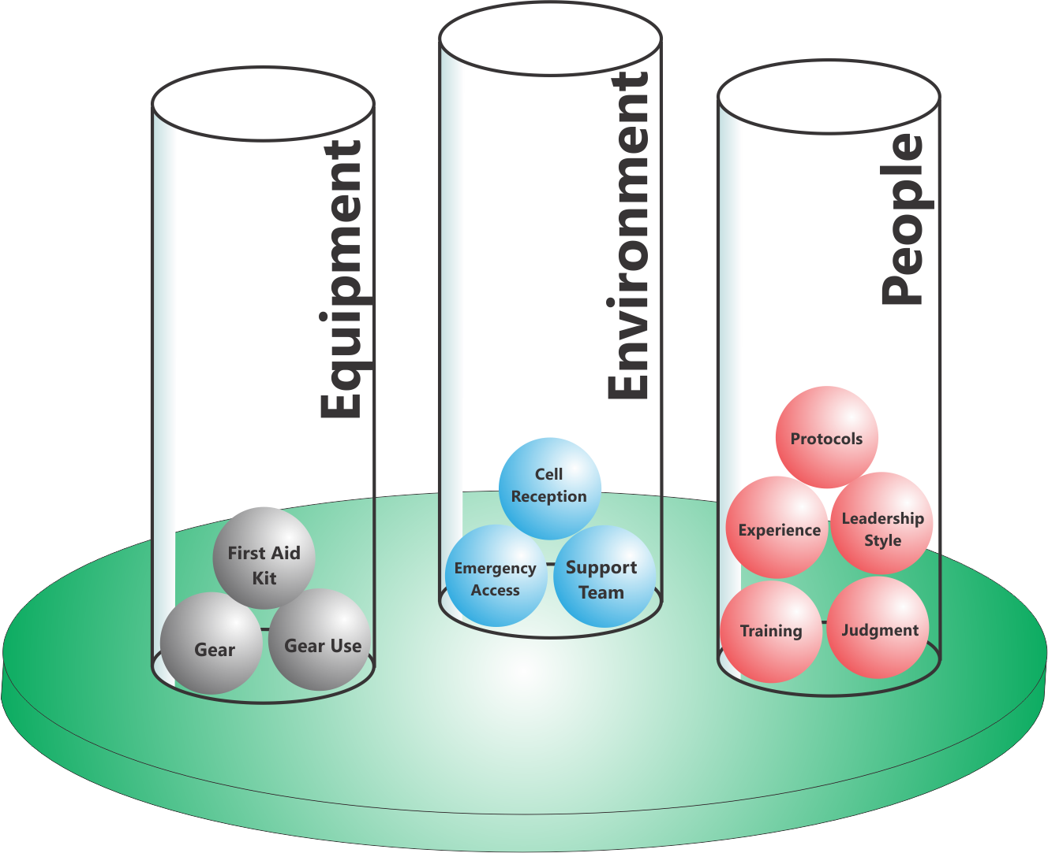
Safety Factors
Notes:
Scales of course mean that there is something being balanced against; those are the positive factors —Safety Factors — that work to reduce the potential for loss. Once again we can see each of the Safety Factors as balls, the more balls in the cylinders the greater the “Safety Weight” on the scale. Safety Weight acts to counterbalance Hazard Weight.

Slide 28
Safety Factors
Equipment
Proper Equipment in good repair
First Aid Kit
Cell or Satellite Phones
Environment
Avoid areas with high avalanche danger
Good emergency access
People
Correct Leadership Style
Good Judgment
Skills Training
Protocols
Notes:
Here are some examples of Safety Factors in each of the three areas. Equipment Safety Factors, Environmental Safety Factors and People Safety Factors. You can present these or have the class brainstorm a list.
This is a place where I introduce the concept of protocols. I ask the group to define a protocol. (Typically a standard operating procedure). I then give examples of protocols from our program such as when canoeing on the river everyone always wears a life jacket. I explain that some protocols are always in place (like this example). Other protocols may be implemented in different situations (some up with an example from your program). They key to this is the issue of leader judgment. There will be times when the leaders have to decide if they need to implement a particular protocol (we’ll give an example in a later slide). I talk about protocols as ‘someone else’s experience that is packaged to help you.’ For example, lightning procedures. Most programs have never had a lightning strike, but there are a set of procedures for what to do.
Here is an example of when a protocol is not always implemented (which you could also bring in later). When doing a stream crossing with a backpack it is a common protocol to undo your hipbelt. But if the stream is only has 6 inches deep, it's not necessary for everyone to undo their hip belts in order to walk across. Leader judgment becomes essential to assess the risk and determine if the water is deep enough that taking hipbelts off is an important Safety Factor.
If the group understands the Situational Leadership Model and different styles of leadership, you can mention how the correct leadership style can be an important safety factor.

Slide 29
Risk Assessment & Safety Management Model (RASM) ©
Notes:
Now we are seeing the other side of the RASM model.
On the right side we now see another part of the balance scale−the Safety Factors−in three categories as before: Environmental Safety Factors, Equipment Safety Factors, and People Safety Factors. When we add “balls” into the Safety Factors we make the risk level go down. Of course it will never go to zero, but we can reduce the risks by adding Safety Factors in.

Slide 30
Safety Impact
Just as with Hazards the same Safety Factor can have a greater or lesser impact depending on the situation.
River Rescue Training is designed to respond to:
Boat Pinning against Rock
Foot Entrapment
River Rescue
Notes:
‘Not All Balls are the Same Size’
Just like Hazard Balls the impact of Safety Balls is different in different situations. Here is an example of a Safety Ball—River Rescue Training. It can be used to help deal with a boat being pinned against a rock and to deal with foot entrapment—a potentially life threatening situation (river rescue training is for a lot more but we’ll keep it simple for this presentation).

Slide 31
Safety Impact = ‘Ball Size’
Class 1 Flatwater River
Boat Pinning Frequency Very Low * Severity Low = Low Risk (0.5)
Foot Entrapment Frequency Very Low * Severity High = Low Risk (0.5)
River Rescue
Safety Impact = 1
Notes:
Let’s imagine we are paddling on a small river with very little current. The chances for a canoe to get pinned by the current are quite low and similarly the chance for a foot entrapment are low. Therefore these ‘hazard balls’ are quite small. As a result the need for river rescue training is greatly reduced. In this case the impact the Safety Ball would have is actually small. Once again these numbers are arbitrary and exist just to illustrate the point.

Slide 32
Safety Impact = ‘Ball Size’
Class III Whitewater River
Boat Pinning Frequency Moderate * Severity Moderate = Moderate Risk (5)
Foot Entrapment Frequency Low * Severity Very High = High Risk (20)
High Altitude (12)
River Rescue
Safety Impact = 25
Notes:
On a Class III Whitewater river the risks of boat pinning or foot entrapment increase significantly. So River Rescue Training is a much more significant Safety Factor in reducing the Risk Level. What this means is that it is important to understand the impact a particular Safety Factor will have and determine which will get you the most ‘bang for the buck.’

Slide 33
Reduce the Risk Level
How Do You Reduce the Risk Level?
Remove all the Hazards you can
What if that’s not Enough?
Add Safety Factors
Notes:
Here we continue to build the model.
To Reduce the Risk Level
Remove or Reduce all the Hazards you can
Add Safety Factors in to “counterbalance” the Hazard Factors

Slide 34
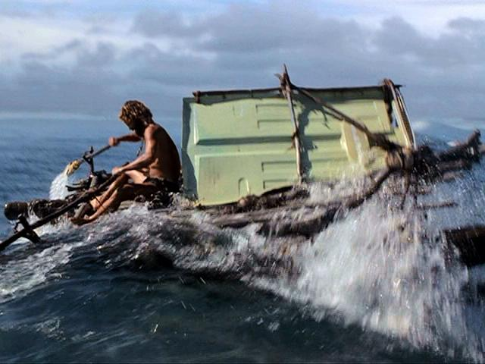
“Real Life” Examples
Cast Away Scene 2
DVD Chapter 23
Notes:
Now we are going to take another look at Tom Hanks in Cast Away. In case people haven’t seen the movie, at this point he has survived alone on the island for 1500 days. This is one of the few examples that I’ve found in movies where you can see the same scenario where the person has altered some of the factors and thereby reduced the risk level. Ask them to watch the clip and see what they can identify as being different this time around.
Show Chapter 23 of the DVD (starting around minute 1:34:00) from the time when the wind changes to direction and he sends his raft into the water until he gets through the wave.
After the video go back to the classes earlier brainstorm list of his initial accident and see what has changed (see the next slide).

Slide 35
Hazard Factors
Equipment
Environment
People
No Food Water
Fear / Anxiety
Paddle
Huge Waves
Indecisive
Raft
Coral Reef
No Plan
Notes:
This slide illustrates how Tom Hanks was able to eliminate or reduce some of the Hazard Factors in the situation. Point out that the huge waves and the coral reef are still there, those, like some Hazard Factors in other situations, can’t be eliminated. In terms of fear and anxiety, I ask, “Was he afraid?” Yes, but less so.
You can also add some fun in here. If people know the movie, the first time he was alone. The second time he had his companion, Wilson.

Slide 36
Safety Factors
Equipment
Environment
People
Sail
Determined
Food Water
Decisive
Paddles
Wind
Plan
Raft
Notes:
Reducing the Hazards wasn’t the only thing he did. He also added Safety Factors in. Some of these are in fact the same things that were hazards before. The underinflated raft in the first attempt was a hazard and has now been replaced with a much bigger, sturdier raft with much greater flotation and speed.
Also, ask them about what else he used to get over the wave. He used a sail. He realizes that even with huge oars he can’t paddle up over such huge waves. He needs the wind. [Note: A subtle detail of the movie is that for most of the year the wind blows in to the island. At a certain season the wind changes direction (as shown by the direction change of his ‘wind sock’ at the beginning of the clip). Tom knows this and has specifically planned his escape at that time of year. He has everything ready and is waiting for the wind to change.]
Then go into some of the People Safety Factors that he has added in.
These two clips do a great job of illustrating the entire model.

Slide 37
Risk Assessment & Safety Management Model (RASM) ©
Notes:
So now we are back at the overview of the model and I think you have a good sense of the dynamic interaction that this model provides.
Now let’s put it all together. The Hazard Factors operate to push the Risk Level up while the Safety Factors operate to pull the risk level down. For simplicities sake on the illustrations, all the balls are shown as the same size. As we’ve shown some may be much larger than others and ‘weigh more’ having a much greater or lesser influence on the ultimate Risk Level. For example having a hurricane hit your trip is a massive hazard factor made up of a series of conditions (high winds, downed trees, flooding, temperature, etc.)

Slide 38
Some Hazards can’t be Removed
First Aid Training
People
Allergic Person
People
Benadryl
Equipment
Bees
Environment
Equipment
Epi- nephrine
Hazard Factors
Safety Factors
Low
High
Risk Level
Notes:
I like to reinforce the idea that some hazards can’t be removed and that only by adding Safety Factors in can you reduce the Risk Level. In this example having an environment with bees on the trail and having someone on the trip who is allergic to bees are the things increasing the Risk Level. You can’t remove these things so all you can do is to add Safety Factors on the other side of the equation to reduce the potential severity of the situation if the person gets stung.
Note: Some programs may not carry medications like Benadryl and Epinephrine or allow their staff to use such things. In that case you should come up with your own example that illustrates this point. Or you can refer people back to the Tom Hanks scenario where the waves and the coral reef were still there.

Slide 39
Reduce the Risk Level
How Do You Reduce the Risk Level?
Remove all the Hazards you can
What if that’s not Enough?
Add Safety Factors
What if that’s not Enough?
Bail Out!
Notes:
Here we continue to build the model.
To Reduce the Risk Level
Remove or Reduce all the Hazards you can
Add Safety Factors in to “counterbalance” the Hazard Factors
Bail out of the Risk Level is still too high after removing/reducing Hazard Factors and adding Safety Factors

Slide 40
Implementing RASM in your program
Know when to ‘bail out’
If the Risk Level is too high, what is your expectation of your leaders and their expectation
Notes:
Ask the class what happens when the Risk Level is high and you cannot bring it down to an acceptable level by reducing Hazard Factors or adding Safety Factors. The answer is to bail out. I give a detailed example from my program where leaders have made a good decision by bailing out. They looked at the situation and determined that there was no way to continue without a significant level of risk.
When you can’t bring the risk down, look at ‘changing the game.’

Slide 41
More Safety Balls?
Many people ask why not add every Safety ball you possibly can to the right side?
Notes:
A good question is why not just throw in all the possible ‘safety balls’ from the beginning. The answer is more subtle than at first glance so the next slide gives an example from whitewater river running.

Slide 42
Changing Protocols to Manage Risk
Whitewater Class | Protocols/Actions
Class 1 | Base Level: Everyone is wearing a life jacket. Leaders have basic equipment, river knowledge, check river conditions
Class 2 | + Lead & sweep boats or buddy system, Basic river rescue equipment
Class 3 | + Scouting from boats, River rescue training
Class 4 | + Scouting from shore, Safety boats
Class 5 | + Screening of paddlers, Safety Lines set up
Class 6 | + Decision-making plan for running rapid
Notes:
Let's take a look at a real world example. Many people are familiar with the rating system for the difficulty of whitewater rapids. It starts at Class 1 which is basic moving flat water goes to Class 2 which is minor rapids requiring some maneuvering, up to Class 3 more difficult rapids and all the way up to Class 6 which is considered risk of life for a team of experts. In this table we can equate the whitewater class level with an arbitrary risk scale in this case one to six. When paddling on a Class 1 river there are some basic safety factors that are in place: a basic paddling knowledge of the river and checking river conditions, teaching paddling skills, everyone wearing a PFD, etc. These are things that we do in any situation when we are on the water.
When we go to a Class 2 the section of river we add additional safety protocols. We are still using all of the protocols that we established for Class 1 and in addition, for example, we might have lead and sweep boats or use the buddy system, and have basic river rescue equipment and training like a throw bag. In the Class 1 situation these safety factors might not be considered necessary. So it's not the case that we suddenly add every possible safety factor into the equation at the very beginning. We evaluate the risk levels and hazards and add safety factors in as we feel they're needed. That’s where leader judgment comes in (we hinted at this earlier).
So now let's take a look at Class 3 whitewater. In this situation on top of the other protocols that we already are using we add some additional ones. We may scout each rapid from the boats before running them. Instructors are required to have river rescue training.
Another thing we can do is to set a program protocol that says we don’t do anything harder than Class 3 whitewater. That helps keep the level of risk from continuing to go up. It doesn’t mean there is no risk at Class 3, quite the contrary, but the risk level is certainly less than in Class 4.
In addition to this in Class 4 we stop and scout each rapid from shore. We may set the safety boat somewhere along the rapid in case anyone flips. For Class 5 rapids we actively screen the paddlers who are going, we may scout everything from shore, and we may set throw lines along the most difficult sections of the rapid or those with the most serious consequences if there is a swim. Finally, in a Class 6 situation in addition to everything else that we've been doing before we also have an established decision-making plan, agreed upon by all group members ahead of time, about how to decide whether the group and individuals are to run a particular drop.
So this is a great example of how changing risk levels relate to changing safety levels. You can see that the whole system is dynamic: we have hazard factors changing risk levels, and safety factors changing risk levels.
[Note: I consciously use numbers rather than Roman numerals for the Whitewater Class since that might confuse people who don’t know the standard river rating system]

Slide 43
Utilizing the RASM Model
Identify the negative Hazard Factors that serve to increase the Risk Level.
Identify the positive Safety Factors embodied in your programs which are designed to counteract hazards and decrease the Risk Level.
Assess the current Risk Level and apply the appropriate policies/procedures for that level.
Reassess the Risk Level and have a plan if the Risk Level does not go down enough.
Notes:
Overview of the model
Identify the negative Hazard Factors that serve to increase the Risk Level.
Identify the positive Safety Factors embodied in your programs which are designed to counteract hazards and decrease the Risk Level.
Assess the current Risk Level and apply the appropriate policies/procedures for that level.
Reassess the Risk Level and have a plan if the Risk Level does not go down enough. Be ready with ‘bail out’ options.

Slide 44
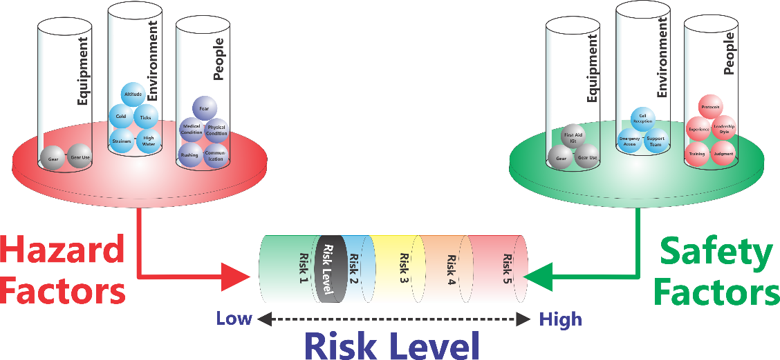
RASM Analysis
Activity ____________
Location ___________
Season ____________
Hazard Factors |  |  | Risk Level | Safety Factors
Equipment | Environment | People |  | Equipment | Environment | People
Notes:
This slide shows a sample form that can be used by staff to assess potential risk before going on a trip and looking to see what Hazard Factors may be present and what Safety Factors may be implemented.
I ask if anyone has ever been hiking in the desert. If so I ask if anyone knows what you do in the morning before putting your boots on. Shake them out to make sure there are no scorpions inside. We don’t operate in the southwest so this is something that our leaders don’t need to know about. But going to a new area, activity, location, etc. means researching that area and understanding the potential hazards and knowing how you may have to respond.
You can brainstorm or discuss other examples. (I also use summer afternoon thunderstorms in the Rocky Mountains and the need to plan a route to be down off high ridges and summits early. Other examples are glacier climbing early in the day before the sun melts things and rock fall increases.)

Slide 45
Discussion
What is the “typical” Risk Level our program operates at? How much variation is there?
Do our Safety Factors outweigh our Hazard Factors?
How often do we shift into a higher Risk Level on a program?
Are we set up to allow protocols to change as we shift into different Risk Levels?
What do we need to do to implement this system in our organization?
Notes:
These are some important discussion questions to have the group discuss.

Slide 46
Implementing RASM: Program Level
Look at each activity you do and assess…
Hazard Factors in each of these categories…
Environment
Equipment
People
Safety Factors in each of these categories…
Environment
Equipment
People
What Risk Level(s) you are comfortable operating with and are appropriate for your program goals?
Notes:
This slide explores how to implement the RASM model in your program. For each activity (backpacking, rock climbing, etc.) you should
Assess the Hazard Factors
Environmental Hazard Factors
Equipment Hazard Factors
People Hazard Factors
Assess your Safety Factors to deal with the potential hazards
Environmental Safety Factors
Equipment Safety Factors
People Safety Factors
Decide if the Risk Level is acceptable
Based on your assessment you need to decide if this activity can be done at an acceptable risk level given your program’s resources.

Slide 47
Implementing RASM: Field Staff Level
Pre-trip
Assess the Hazard Factors
Environmental Hazard Factors
Equipment Hazard Factors
People Hazard Factors
Prepare an Hazard Briefing for participants
Assess your Safety Factors to deal with the potential hazards
Environmental Safety Factors
Equipment Safety Factors
People Safety Factors
Decide if the Risk Level is acceptable
Notes:
Once you are doing an activity before a trip goes out you need to have field staff run through this same process.
Assess/Review the Hazard Factors
Environmental Hazard Factors
Equipment Hazard Factors
People Hazard Factors
Prepare an Hazard Briefing for participants
What do they need to know to keep themselves safe
Assess/Review your Safety Factors to deal with the potential hazards
Environmental Safety Factors
Equipment Safety Factors
People Safety Factors

Slide 48
Implementing RASM: Field Staff
During the Trip
Teach the RASM Model to Participants
Assess
Environmental Hazards
People Hazards
Equipment
Increasing Risk Level/Accident Potential
“Treat” all the Hazards you can
Add additional Safety Factors if necessary/possible
Reassess Risk Level
If it’s still too high, change things
Notes:
During the trip leaders should use the RASM model to regularly assess the situation for Hazard Factors and for increasing Risk Levels. Using a standard medical model you should “treat” (remove) all the Hazard Factors you can and “treat” (add) all the Safety Factors you can and then reassess the situation.
I remind people of the Patient Assessment System (PAS) taught in many first aid courses. This is a model that they probably know already and RASM mirrors this approach. Giving them another tool that syncs with logical frameworks they already use helps them remember.

Slide 49
Implementing RASM: Post Trip
After the Trip
Turn in detailed Incident/Accident Reports
Turn in Close Call/Near Miss Reports
Notes:
Gathering data for both accidents and close calls is essential to get the full picture of potential risk. Remind people about the Accident Iceberg and any examples you gave there.
Using whatever your program’s format is people should turn in both accident reports and close call reports. This is a time to reinforce with leaders how critical this is to overall risk management.
Note: People interested in tools for collecting and managing incident data should refer to the International Incident Database Project (www.incidentdatabase.org)

Slide 50
Analyzing an Accident
Reviewing existing accidents or near misses in your program using the model is a useful technique to assess your program
Analyze an Accident in small groups
Notes:
It can be really helpful to analyze accidents or near misses from your own program (preferably things that are not going to be difficult or embarrassing for current staff).
At this point if you wish you can go into your own Case Study (or see some of the sample case studies in the appendix). Having small groups analyze an incident and identify the Hazard Factors and Safety Factors can be a good group exercise. The depth you go into depends on your audience and the time you have.
You can present them with something from your program or bring in some other outside event. I’ve used things like the 1996 Everest Expedition chronicled by Jon Krakauer in “Into Thin Air.” Deb Ajango’s book “Lessons Learned’ has details about the Ptarmigan Peak accident. Large scale events like Hurricane Katrina can also be analyzed using the RASM model.

Slide 51
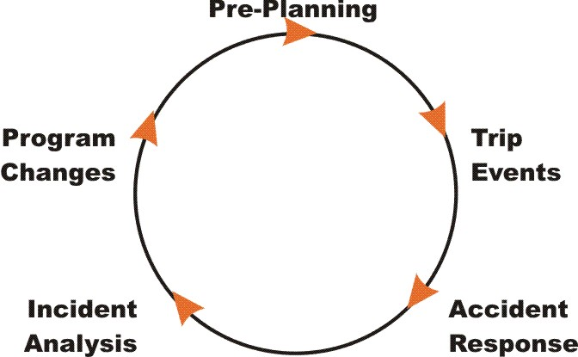
Implementing RASM in your program
Notes:
Everyone in the organization needs to think about the full cycle of the RASM Model. You implement the model in your pre-planning process. During a trip staff are assessing the situation and responding to trip events to keep the Risk Level at an acceptable level by removing Hazard Factors and/or adding in Safety factors. After a trip is over you need to record and analyze both incidents and close calls in order to determine if changes should be made to current program operations. Then the cycle starts again.

Slide 52
Risk Assessment & Safety Management Model (RASM) ©
Notes:
So now we are back at the overview of the model and I think you have a good sense of the dynamic interaction that this model provides.
Now let’s put it all together. The Hazard Factors operate to push the Risk Level up while the Safety Factors operate to pull the risk level down. For simplicities sake on the illustrations, all the balls are shown as the same size. As we’ve shown some may be much larger than others and ‘weigh more’ having a much greater or lesser influence on the ultimate Risk Level. You manage risk by identifying and reducing Hazard Factors and/or by adding in Safety Factors.

Slide 53
Take Home Action Steps
For each program activity brainstorm a list of Hazard Factors in each of the three major categories (Environment, Equipment, People)
For each program activity brainstorm a list of Safety Factors in each of the three major categories (Environment, Equipment, People) designed to mitigate against Hazard Factors
Notes:
These are some key Take Home Action Steps for anyone planning to implement the RASM model.

Slide 54
Take Home Action Steps
Balance the Hazard Factors against the Safety Factors and determine the range of Risk Levels you will be operating in. Based on your program, decide whether the Risk Level is acceptable or not.
If the Risk Level is not acceptable, assess how to modify Hazard Factors and Safety Factors to reduce the Risk Level.

Slide 55
Resources
www.OutdoorEd.com Search for RASM or risk management
www.IncidentDatabase.org International Incident Database Project
Copyright © 2007 Rick Curtis, Outdoor Ed LLC. All rights reserved.
Notes:
Resources and Bibliography

Slide 56
Sample Case Studies
Another technique is to present participants with a Case Study and ask them either individually or in small groups to brainstorm the Hazard Factors and potential Safety Factors for an incident. Then go over the answers with them afterwards. A few samples are included and you can create your own.
Notes:
Another technique after presenting the model is to give participants with a Case Study and ask them either individually or in small groups to brainstorm the Hazard Factors and potential Safety Factors for an incident and determine what actions they could take to reduce the Risk Level and go over the answers with them afterwards. A few samples are included and you can create your own.

Slide 57
Backpacking Trip Scenario
Sally is leading a group of 7th graders on the school’s annual 4-day wilderness trip. This is Sally’s fourth such trip. Dan the other teacher from the school is new this year and doesn’t have any backpacking experience. But it’s hard to find teachers at the school who are willing to go. Dan is young and a good athlete and seems to be learning quickly. It’s early September in the Shenandoahs and the group of 8 students and two teachers has started their second day of hiking. The temperature has soared up to the nineties with humidity around 80%. The group slept in and cooked pancakes so they got a late start on the trail. After a 2 mile hike, the group stops for lunch. Sally notices large cumulus clouds starting to build over the ridge. It’s already after one o’clock and eager to get on to camp, they finish lunch and head off for a long descent down Little Devil’s Staircase, a ledgy section of rock trail along a dry stream gorge.
Notes:
Let the group read the following scenario. Then have them brainstorm the following:
What are the Environmental, Equipment and People Hazards?
What hazards can be removed?
What Safety Factors could be added in to reduce the Risk Level?
What other possible accidents could have occurred in this scenario?
What would be needed to reduce the risk of these other possible accidents?

Slide 58
Backpacking Trip Scenario
The upper section of the gorge is dry and the rock is slick and polished. As the afternoon progresses, the group is moving more slowly down the gorge. The smaller students are having trouble handling the steep sections and slick rocks with their packs. More than once Dan has had to take a student’s pack as well as his own over the difficult sections. The clouds have now become thick thunderheads and the sky is darkening. They can hear thunder in the distance. They still haven’t reached the bottom trail. The wind is picking up and large raindrops are spattering here and there on the rocks. Suddenly the sky opens up and the rain is falling in torrents. Dan, while carrying a student’s pack, slips on the wet polished rock and falls backwards striking his head sharply against a boulder. The student next to Dan screams. Sally is at the front, picking her way down the trail when she hears the scream. She drops her pack and scrambles up to Dan who is unresponsive when she first arrives. She quickly checks for breathing and pulse and then Dan starts to open his eyes.

Slide 59
Backpacking Trip Analysis
Environmental Hazards
Rocky trail
Wet trail
Rain
Lightning
Heat
Humidity
Dehydration
People Hazards
Group of kids
Age of kids - their physical abilities and experience
Dan’s inexperience
Limited group resources in an emergency
Equipment Hazards
Too much weight in packs

Slide 60
Whitewater Kayaking Scenario
It’s been raining steadily for several days. The rivers are rising, and local boaters are getting itchy. After all, it’s been a long winter and the promise of rising water and rising temperature is too good to miss. Sarah feels it. She’s a good Class IV kayaker, 29 years old, physically strong. She’s a little out of shape after the winter off, but she’s itching to get back on the river. One of her paddling partners calls Friday night and says, "tomorrow morning: season opener."
Excited, Sarah starts digging her gear out of the closet. The next morning, Sarah meets her four friends at the put-in. It’s a Class III run they know well--a good place to warm up for the spring season. The river is higher than usual with the rain--by about a foot and a half. The water has that muddy brown color and touches the treeline, inundating most of the familiar eddies. After a careful look, they decide to make their run.
Notes:
Let the group read the following scenario. Then have them brainstorm the following:
What are the Environmental, Equipment and People Hazards?
What hazards can be removed?
What Safety Factors could be added in to reduce the Risk Level?
What other possible accidents could have occurred in this scenario?
What would be needed to reduce the risk of these other possible accidents?

Slide 61
Whitewater Kayaking Scenario
The group starts to work its way down the entrance rapids generally aware of where everyone is. After a mile, the group settles in to a paddling pace. Sarah stops to surf her favorite hole, the rest of the group continues around the bend because there are so few eddies where they can stop and watch. The hole is grabby in the high water. Sarah does a few spins and then moves to exit the hole, but gets pulled back in to the deep trough. She tries to get her bow out into the current to pull herself out, but drops back in and flips. She rolls back up but then flips over again. After three more rolls Sarah is exhausted and comes out of her boat.
Before she can recover from the initial shock of the cold water, Sarah and her kayak flush out of the hole. The current pushes Sarah and her boat toward a fallen tree at the outside bend of a turn. The water is too swift for her to swim away. She turns and swims toward the strainer and manages to pull herself up onto it. She watches her paddle and swamped kayak disappear around the bend. When the others see the boat, they quickly take out and work their way back upstream through the flooded shoreline to retrieve Sarah, shaken but unharmed, from the tree.

Slide 62
Whitewater Kayaking Analysis
Environmental Hazards
Cold water
Higher than usual water level
Water in the trees increases the number of strainers
Few eddies, party gets split up
Bend in the river impairs sight lines
Sticky hole
People Hazards
Sarah hasn’t paddled for a while
She is pushing harder than she should with more difficult conditions
Sarah gets tired
She gets separated from group
No rescue backup from group

Slide 63
Whitewater Kayaking Analysis
Reducing Risk Level
Environmental Safety
Pick a different ‘season opener’
See if anyone has run it at this level
Ensure everyone has proper cold weather gear
Ensure that proper river rescue gear is carried
People Safety
Establish better communication if someone wants to stay at a certain spot.
Have a protocol so that no one is paddling alone ("buddy system“).
Be more conservative in paddling when conditions are more difficult and you are tired.
Modify the approach to river running so that the group stays together when the Risk Level increases.
Scout drops more frequently and discuss as a group what to play

Slide 64
Sea Kayaking Scenario
John was introduced to sea kayaking about a year ago at a symposium sponsored by a local outfitter. Looking for a new sport John bought a kayak, paddle, spray skirt and life jacket. He taught himself to paddle on a nearby lake. Except for what he gleaned from a few books, he doesn't have any formal training. His most adventurous trips have been two six-mile paddles out on the bay on calm days. John met someone at work who kayaks with a local club. She tells him the club is having a coastal trip next weekend. It’s a 3 1/2 mile crossing to a small island where they’d have lunch, explore some tidal pools, and come back. John agrees, excited about his first "real" paddling trip. John spends the next few evenings on the lake practicing his strokes and braces on power boat wakes. He buys a flashing signal light for his life jacket, and a whistle, but the paddling shop was out of float bags, so he’ll have to do without.
Notes:
Let the group read the following scenario. Then have them brainstorm the following:
What are the Environmental, Equipment and People Hazards?
What hazards can be removed?
What Safety Factors could be added in to reduce the Risk Level?
What other possible accidents could have occurred in this scenario?
What would be needed to reduce the risk of these other possible accidents?

Slide 65
Sea Kayaking Scenario
When John arrives at the put-in the wind has started to kick up. The 3-foot waves are crashing on the gravel beach. John sees his friend among huddle of people and joins her. After introductions, people wander back to their cars to get their gear. Most people pull on dry tops or wetsuits. John pulls a paddle jacket over his wool sweater and carries his boat to the water.
After several attempts at getting off the beach, John manages to pick his way through the surf and into deeper water. He is paddling hard to catch up with the rest of the group when a wave crests over his stern. Before he can really think, John leans away from the wave on a brace. His paddle sinks and he’s over. The sudden cold water on his face makes John panicky. He struggles out of his boat and pops up beside it, holding on to the grab loop and his paddle. He blows his whistle and the group quickly responds. But the cold water and the wind have taken their toll, and by the time John is back in his boat, he’s shivering violently. The group guides him back into shore to get warm.

Slide 66
Sea Kayaking Analysis
Environmental Hazards
Difficult sea conditions - high wind and chop
Cold water
Equipment Hazards
Improper clothing for the conditions
New boat
No flotation
People Hazards
John’s paddling ability and experience weren’t sufficient for this trip.
He succumbed to his own pressure to go-not once, but twice. John agreed to go without asking about the conditions he’d encounter. When he arrived at the put-in, he decided to go on the trip because the other paddlers seemed ok about it.
Someone in the club should have asked John about his skills before taking him along.
Once on the water, John’s nervousness got in the way of clear thinking leading to his flip.

Slide 67
Sea Kayaking Analysis
Reducing John's Accident Potential
Environmental Safety
Select a different trip location
Equipment Safety
Install float bags.
Use proper clothing.
People Safety
Develop better skills.
Seek feedback from other paddlers about his ability to handle the trip.
Group should assess paddler’s experience level
Know when to say no if conditions are beyond your ability (especially at the put-in).

Slide 68
Appendix Slides
These are some additional detail slides that you can incorporate into your presentation.

Slide 69
Environmental Hazards
Environment
Rocky trail
Exposed ledges
Cold temperatures
Rain
Darkness
Overexposure to sun
Poison ivy
Bees
Notes:
These some additional examples of Environmental Hazards.

Slide 70
Environmental Hazards
Crossing & Hiking Along Roads
Fast Traffic
Poor Visibility
No Shoulder
Driving
Bad road conditions
Darkness
Unfamiliar road
Difficult road (CLASS 1 - 6)
Notes:
These some additional examples of Environmental Hazards. Driving is the most dangerous activities that groups engage in. Roads are also dangerous since they bring cars into close contact with people (ex. Road crossings). In like to remind people that driving is a lot like whitewater kayaking. Not all roads are the same to drive, some are much more hazardous than others. To import the Whitewater River Classification as a metaphor, a long straight road, with good visibility, a shoulder on a dry day might be considered a Class 1 road in terms of general risk level. A windy mountain road in wet or snowy conditions, with decreased visibility or at night could be a Class 5 driving situation. Just like you wouldn’t put someone who is only a Class 2 kayaker in a Class 5 rapid you shouldn’t put a Class 2 driver into a Class 5 driving situation. This factor often gets ignored because people treat driving as a ‘universal skill.’ It’s not.

Slide 71
Equipment Hazards
Broken stove
Boots not broken in
Improper clothing
Inoperative equipment
Improper food
Notes:
These some additional examples of Equipment Hazards.

Slide 72
People Hazards
Everyone
Medical Conditions
Physical Condition
Fatigue
Notes:
These some additional examples of People Hazards that apply to everyone.

Slide 73
People Hazards
Participants
No awareness of hazards
No skills to avoid hazards
Won’t follow instructions
Irresponsible/careless attitude towards self, others, equipment
Poor physical strength, stamina
Need to "prove" self, macho attitude
Fear/anxiety
Notes:
These some additional examples of People Hazards that apply to participants.

Slide 74
People Hazards
Leaders
Lack of knowledge of environmental hazards
Inadequate skills to extricate group and self from hazards
Poor safety judgment
Poor teaching skills
Instructions unclear
Poor supervisor, does not correct problems
Ineffectual under stress
Notes:
These some additional examples of People Hazards that apply to leaders.

Slide 75
People Hazards
Group
group not yet formed, lacks cooperative structure
interpersonal frictions unresolved
poor communication
excessive competition
lack of concern for slow or different individuals
excessive pressure or stress to “perform”macho
no practice in working harmoniously under stress
splintering into sub-groups
Notes:
These some additional examples of People Hazards that apply to the entire group.

