Slide 1
NFPA 70E: STANDARD FOR ELECTRICAL SAFETY IN THE WORKPLACE Changes to the 2015 Edition
Joe Cobb Crawford, P.E.,C.E.M.
Crawford Engineering Services
Toccoa, Georgia

Slide 2
Electrical Safety Essentials: An NFPA Trilogy

Slide 3
Electrical Room for Blind?

Slide 4
CODES AND STANDARDS
CODE: Set of recommended rules.
STANDARD: How to meet the rules.
Neither is a law, but can be adopted as law.
A CODE tells you what you need to do; A STANDARD tells you how you can do it.
Hammurabi Code- first developed Building Code was 1955 BC.

Slide 5
TO BE COVERED
What is NFPA 70E? What is NFPA 70?
Tutorial on Arc Flash Hazards.
Top 10 Changes to NFPA 70E.
Q & A.

Slide 6
HISTORY OF NFPA 70
NFPA 70 – National Electrical Code (NEC).
NEC was originally drawn up in 1897.
NEC is NOT a design standard. (See art. #90.1)
NEC is concerned with safeguarding of property.
NEC covers what/how equipment is installed.
NEC has no legal authority until adopted.

Slide 7
HISTORY OF NFPA 70E
NFPA 70E – Standard for Electrical Safety in the Workplace.
First edition published in 1979.
70E is a spin off from NEC for OSHA.
Concerned with safeguarding people.
NEC is further concerned with safeguarding of property.
NEC is NOT a design standard.

Slide 8
IEEE COLOR BOOKS DESIGN STANDARDS

Slide 9
Why Bother With NFPA 70E ?

Slide 10
WHAT IS RISK?

Slide 11
Three Electrical Hazards

Slide 12
ELECTRICAL HAZARDS
Three types:
Electric Shock
Arc-Blast
Arc-Flash
Flash burns are very painful, slow healing and costly
60-80% of electrical injuries are Flash burns
Survival rate is very low for older people

Slide 13
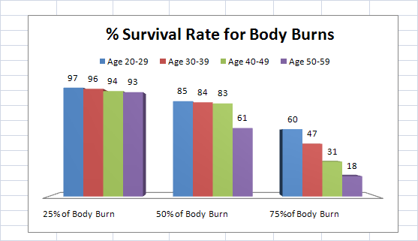
Surviving Arc Flash Burns

Slide 14
HEAT TRANSFER
MODES OF TRANSFER
Conduction
Convection
Radiation
Arc Radiates Energy Quickly!
What is Energy?
“The ability to do work”

Slide 15
ARC FLASH ENERGY CIRCUIT

Slide 16
ARC FLASH 101
Arc Fault is an abnormal electrical circuit condition.
Short circuit current and energy levels are extreme.
Arc Faults begin as “Single Line to Ground” type fault and evolve to “Line to Line to Line to Ground” type fault.
Circuit breakers and fuses attempt to limit the energy level in a faulted circuit.
What determines the current and energy level?
Current = Voltage / Impedance.
Energy = Current x Voltage x Time
What determines the Incident Energy?
Incident Energy = K x Energy/ D*2.2 (cal/cm*2)
Incident Energy determines what PPC is required.

Slide 17
Arcing Short Circuit
Extreme
Heat
Energy is released in various forms.
Trip time of the fuse or breaker is crucial.
Limiting current will limit the Incident Energy
Intense
light
molten metal
Sound
wave
shrapnel
Arc
Hot air
Rapid
Expansion
Copper
vapor
Pressure
Wave
Line 1
Line 2

Slide 18
Incident Energy
Energy per unit of area received on a surface located a specific distance away from the electrical arc, both radiant and convective, in units of calories per square centimeter.
1.2 Cal/cm*2 will result in 80 degree C skin temperature
Safe Distance = ( K x Energy/1.2 )*0.5

Slide 19
Incident Energy vs Distance from the Arc
45,200 Amps with an arc gap of 5 inches.
Closed box incident energy level is more.
Only 1.2 cal/cm*2 will cause second degree burns.
Stay away or wear PPC!

Slide 20
INCIDENT ENERGY EXAMPLE
Volts = 480, Z = 0.1 ohm, Time = 1 Second
Distance = 2 Feet
Current = Volts / Z = 480/0.1= 4800 A
Arc Energy = Amps x Volts x Time
= 4800 x 480 x 1 = 2304000 Watt-Seconds
Incident NRG = 0.0000432 x Energy/D*2.2
= 21.7 Calories/ cm2
Results: Third Degree Skin Burns, Non-FR clothes ignite!

Slide 21
NFPA-70E: ARTICLE 130 Working On Or Near Live Parts
130.5: Flash “Risk” Assessment.
Does a thermal hazard exist?
What PPE do I need to use?
What is the Flash Protection Boundary?
Flash Hazard exists if Incident Energy is more than 1.2 Calories/ cm2
PPE is required unless proven otherwise.
130.4: Shock “Risk” Assessment.

Slide 22
NFPA 70E – 130.5 Assessment Procedure
Gather the data
Confirm the data accuracy
Perform a Short Circuit Study
Perform an Arc Flash Energy Study
Install Arc Flash Hazard Labels
Train Personnel

Slide 23
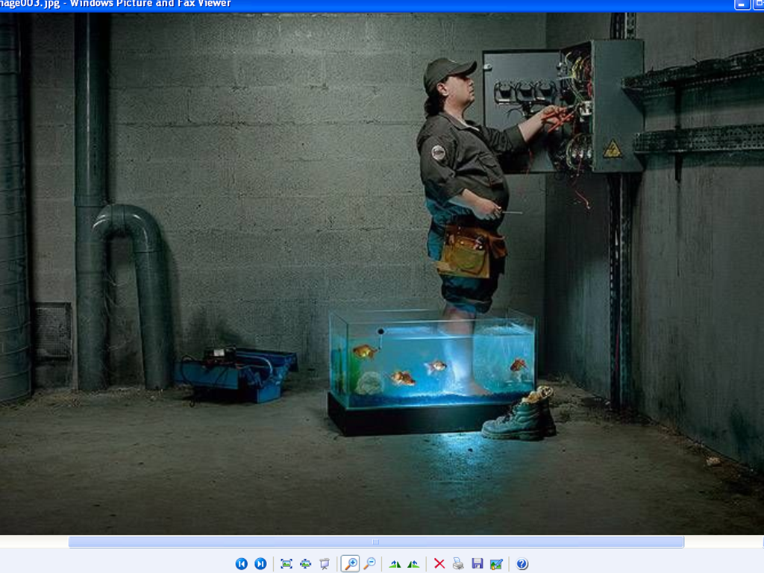

Slide 24
The New and Improved NFPA-70E

Slide 25
Top 10 Changes to NFPA 70E-2015
Article # Topic/Issue
Various Terminology
90.2, 205.3 Maintenance, Training, Auditing
100 “Qualified Person”
110.4(C)(2) GFCI-Maintenance, Construction
120.2(B)(4) Documentation of Training
130.5(C) 2 methods to select PPE

Slide 26
Top 10 Changes to NFPA 70E-2015 Continued
Article # Topic/Issue
7. 130.5(D) Equipment Labeling
8. 130.7(C)(15)(A)(b) Arc Flash Boundary & 130.7(C)(15)(B) Arc Flash PPE Cat
9. 130.7(C)(16) HRC “0” is no more
10. 320.3 Battery Risk Assessment

Slide 27
1) Terminology
Old Term New Term
-Probability -Likelihood
-Hazard Analysis -Risk Assessment
-Results -Effect
-Minimize the hazard -Reduce the risk
-Hazardous electrical -Electrical Hazard
condition
-Work on -Interact with

Slide 28
2) Maintenance, Training, Auditing
New scope: 90.2(A) recognizes equipment maintenance, training and auditing are essentials for safety.
Safe work policy/procedures are audited.
NFPA 70B will determine work procedure.
Article 205.3: Equipment must be maintained, records kept, test decals installed.

Slide 29
3) “Qualified Person”
Article 100: Person is “Qualified” if:
Demonstrated skills and knowledge about the equipment, safety policies and procedures.
Demonstration is documented.
Has received electrical safety training.
Can identify electrical hazards involved on the equipment.

Slide 30
4)GFCI-Maintenance & Construction
All New- Article 110.4(C)(2)- Must use with tools to do maintenance or construction work.
If the voltage is greater than 125 Volts a choice is given:
Use a GFCI or
An assured equipment grounding program.
NEC 590.6(B) (2) details the program requirements.
Grounding test must be documented.
Test period must be less than (3) months.

Slide 31
GFCI Saves Lives

Slide 32
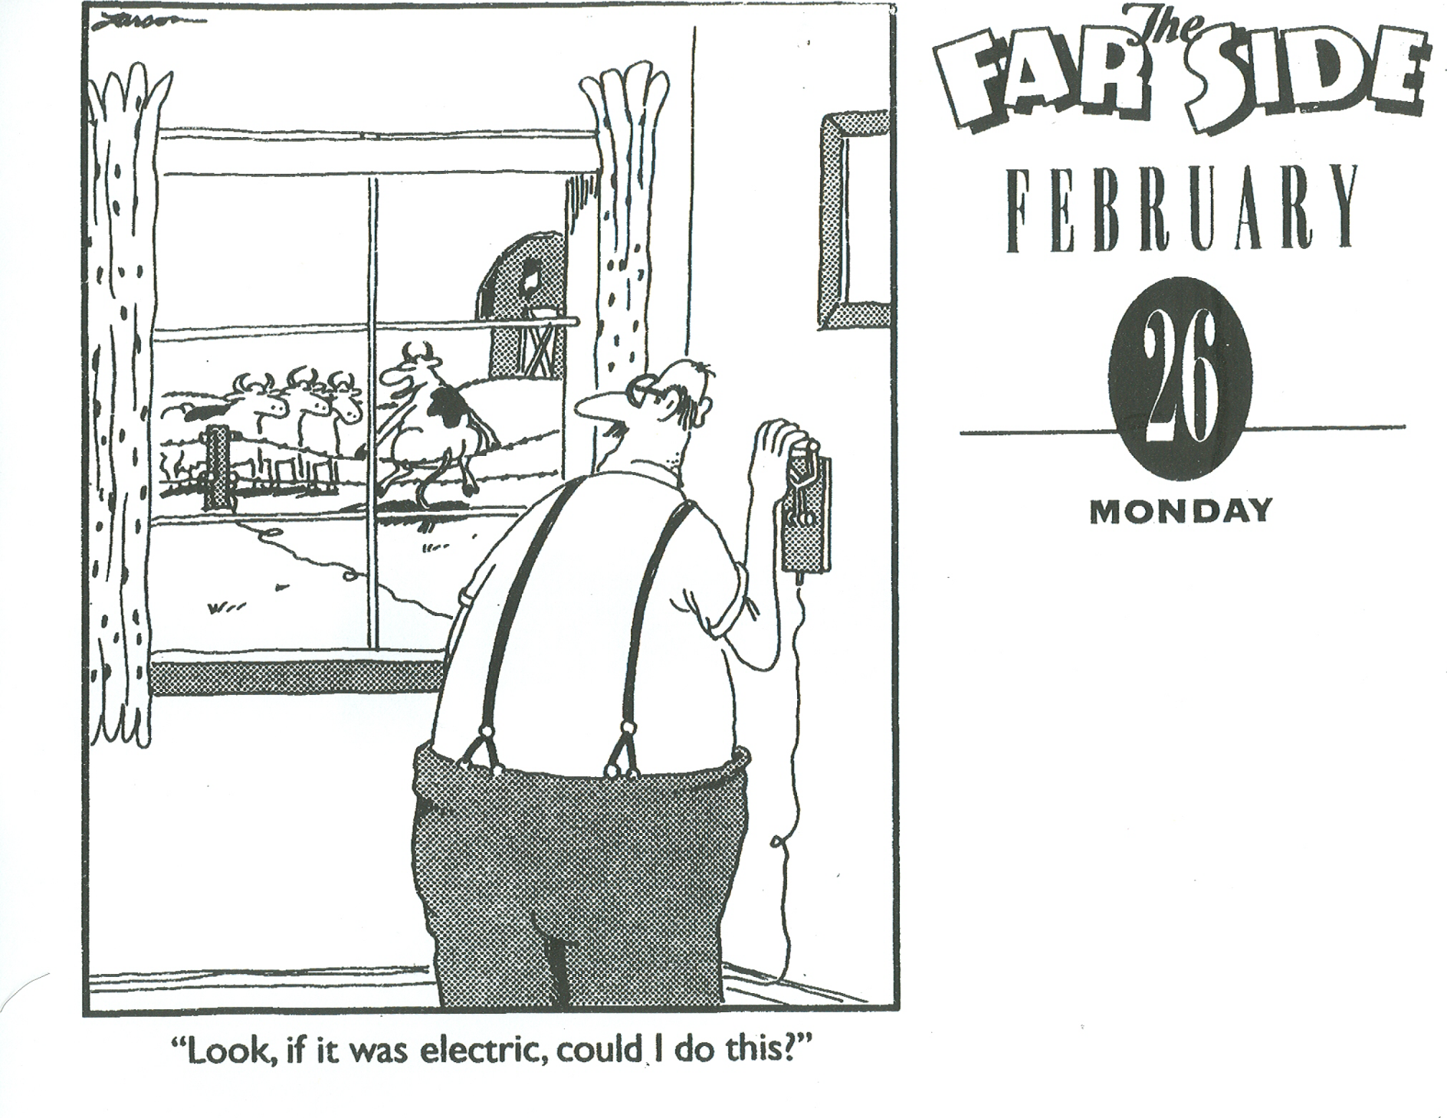

Slide 33
5) LO/TO Training Documentation
All New- Article120.2(B)(4) The employer shall document.
Training must be demonstrated.
Training description details must be given.
Retraining required every three years.
Retraining required if procedure changes.

Slide 34
6) Two methods for selecting PPE Article 130.5(C)
Method #1: Arc Flash Risk Assessment.
- Select PPE rating > Incident Energy.
Method #2: Flash Hazard PPE Category.
- Select PPE based on “Qualifier” Tables.
Options are Mutually Exclusive.
HRC is now PPE Category.

Slide 35
7) Equipment Labeling Article 130.5(D)
Update the label if found inaccurate.
Owner is responsible for label’s:
Documentation.
Installation.
Maintenance.
Review/Re-label.

Slide 36
8) Arc Flash Boundary & Arc Flash PPE Categories Tables
All New Tables. For Method #2 Only.
Qualifier Test Table 130.7(C)(15)(A)(a)
What is the task?
Are all “Equipment Conditions” met?
Is Arc Flash PPE Required?
PPE Category? Table 130.7(C)(15)(A)(b)
Are all parameters met?
If yes: What Category # is required?
130.7(C)(15)(B) = DC Systems Cat. Table

Slide 37
9) R.I.P. Equipment’s HRC and HRC “0”
PPE Table 130.7(C)(16)
It’s about the umbrella and not the rain.
Hazard Risk Category (<1.2 cal/cm*2) Gone!
Category lists PPE and not HRC.
PPE states Protection Equipment’s rating.
No “Adequacy” statement is inferred.
See Annex H for Guidance.

Slide 38
10) Battery Risk Assessment
New Article: 320.3(A)(1)
Electrical and Chemical Risks.
Annex D, Section D.5– Short Circuit Current, Arc Current and Arc Energy Calculations.
Always use battery manufacturer guidance on Short Circuit Current.

Slide 39
CRAWFORD ENGINEERING SERVICES Toccoa, Georgia

Slide 40
One More Not In NFPA-70E
NEC 240.87 Arc NRG Reduction

