Slide 1
Laser Safety
Boston University

Slide 2
Laser Safety Training is offered on line in RIMS and supplemented by your Permit Holder on specific laser systems.
Training is available by the Laser Safety Office
if requested.
The following slide presentation is used for educational purposes

Slide 3
Compliance
Laser Safety Program
MA-DPH 105 CMR 121.00
ANSI- Z 136.1
ANSI-Z 136.3
The Laser Safety Committee (LSSC) observes the MA-DPH regulations and ANSI standards and federal guidelines.

Slide 4
Laser Radiation Committee
Committee
Laser Safety SubCommittee- (LSSC) is a subcommittee of the Radiation Safety Committee (RSC).
Authority to approve/suspend research and health care laser systems privileges property.
The LSSC meets quarterly and the RSC gives final approval to LSSC operations.

Slide 5
Laser Safety Supervisor and Laser Personnel
Responsibilities
Conform to the BU policies and guidelines for the safe use of HCLS & associated laser equipment.
Complete the initial Laser Safety Training prior to entering laser controlled area.
Familiarization with specific departmental policies and procedures.
Provide adequate equipment for safety.
Ensure adequate safety for visitors and untrained personnel
Inform visitors/untrained personnel of the hazards add how to protect themselves
No one without BU laser safety shall be left unattended in the laser system area without supervision.

Slide 6
Laser Safety Supervisor and Laser Personnel
Responsibilities
Accountability of laser radiation workers, laser devices (HCLS) & associated equipment registered with the Laser Safety Officer.
Maintain a safe environment for patients, personnel, visitors, and the general public.
Reports any equipment malfunction or potential hazard to the Laser Safety Supervisor.

Slide 7
Educated Laser Safe Employees
Responsibilities
Provide adequate laser awareness for others
Committed to BU policies and regulatory compliance
Practice safe methods & procedures to eliminate Maximum Permissible Exposure (MPE) to the eye or skin
Notes:
This is a very important part of the equation.
May mean the difference.

Slide 8
Contacting Laser Safety
Contacts
BUMC
Week Day Phone: 617-638-7052
Emergency Pager # 0180 OFF Hours Emergency or Page-Control 617-638-4144 for additional assistance
Charles River Campus (CRC)
617-353-7233 or call Public Safety @ 617-353-2110;
617-353-2121 (emergencies only)
24-hrs. a day there is a staff on call and emergency assistance is available

Slide 9
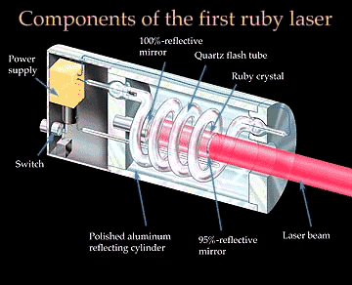
Laser History
Laser History
Stimulated emission, the basis of a laser beam, was first proposed in 1917, by Albert Einstein.
In 1954, American physicist Charles Townes created a device that amplified microwaves, the device was called a MASER.
In 1960 American physicist Theodore Maiman built the first working laser with a ruby rod as the active medium, with a spiral lamp as the power source
American physicist Ali Javan built a helium-neon laser a year later

Slide 10
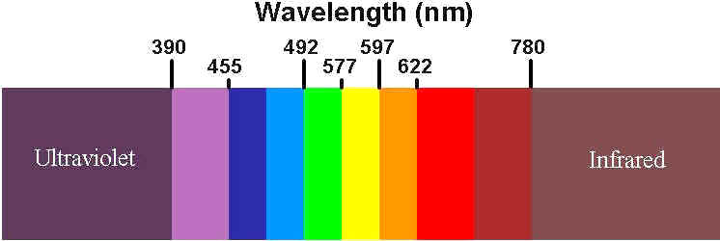
Basic Laser Safety
Laser
What is a Laser?
  Light
  Amplification by
  Stimulated
  Emission of
  Radiation
  The energy generated by a laser is in or near the optical portion of the electromagnetic spectrum

Slide 11

Laser
Basic Laser Safety - EM Spectrum
The optical spectrum
Laser light is nonionizing and ranges from the:
  ultra-violet (100 - 400nm)
  visible (400 - 700nm), and
  infrared (700nm - 1mm).

Slide 12
Lasers
Laser Classification
Class 1- A class 1 laser is safe under all conditions of normal use. This
means the maximum permissible exposure (MPE) cannot be exceeded
Class 1M- A Class 1M laser is safe for all conditions of use except
when passed through magnifying optics such as microscopes and
telescopes. Class 1M lasers produce large-diameter beams, or beams
that are divergent. The MPE for a Class 1M laser cannot normally be
exceeded unless focusing or imaging optics are used to narrow the beam.
If the beam is refocused, the hazard of Class 1M lasers may be increased
and the product class may be changed. A laser can be classified as Class
1M if the total output power is below class 3B but the power that can pass
through the pupil of the eye is within Class 1.

Slide 13
Lasers
Laser Classification
Class 2- A laser is safe because the blink reflex will limit the exposure to no more than 0.25 seconds. It only applies to visible-light lasers (400–700 nm). Class-2 lasers are limited to 1 mW continuous wave, or more if the emission time is less than 0.25 seconds or if the light is not spatially coherent. Intentional suppression of the blink reflex could lead to eye injury.
Class 2M- A Class 2M laser is safe because of the blink reflex if not viewed through optical instruments. As with class 1M, this applies to laser beams with a large diameter or large divergence, for which the amount of light passing through the pupil cannot exceed the limits for class 2.

Slide 14
Lasers
Lasers
Class 3R- A Class 3R laser is considered safe if handled carefully, with
restricted beam viewing. With a class 3R laser, the MPE can be exceeded,
but with a low risk of injury. Visible continuous lasers in Class 3R are
limited to 5 mW. For other wavelengths and for pulsed lasers, other limits
apply.
Class 3B- A Class 3B laser is hazardous if the eye is exposed directly,
or reflected but diffuse reflections such as from paper or other matte
surfaces are not harmful. Continuous lasers in the wavelength range from
315 nm to far infrared are limited to 0.5 W. For pulsed lasers between 400
and 700 nm, the limit is 30 mW. Other limits apply to other wavelengths
and to ultra short lasers. Protective eyewear is typically required where
direct viewing of a class 3B laser beam may occur. Class-3B lasers must
be equipped with a key switch and a safety interlock.

Slide 15
Lasers
Class 4 lasers as a result of direct, reflected, or diffuse, reflecting beams, include all lasers with beam power greater than class 3B. By definition, a class-4 laser can burn the skin, in addition to potentially devastating and permanent eye damage as a result of direct or diffuse beam viewing. These lasers may ignite combustible materials, and thus may represent a fire risk.
Class 4 lasers must be equipped with a key switch and a safety interlock. Most industrial, scientific, military, and medical lasers are in this category.
ANSI 136.1

Slide 16
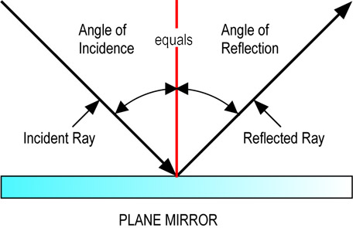
Lasers Physics
Diffuse or Specular?
Specular - Surface irregularities or roughness is < the incident light wavelength
Diffuse - Surface irregularities or roughness is > the incident light wavelength

Slide 17
Lasers Physics
Not all viewing conditions are the same
Specular reflection Convex reflector Concave reflector
Whether a reflection is specular or diffuse for a given surface depends on the laser wavelength. “Smooth” is relative to the laser wavelength.
Diffuse reflection

Slide 18
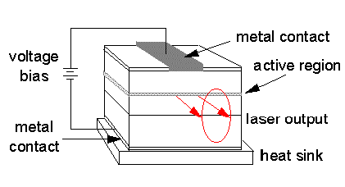

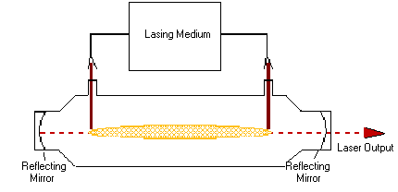
Laser Systems
Laser Components
Active Medium
Solid State-operate in pulsed or CW mode
Semiconductor
Gas - CW Co2, Argon, HeNe, Excimer
Liquid (dye) (CW or pulsed)
Excitation Mechanism (Pump)
Optical
Electrical
Chemical
Optical Resonator
Mirror
Partially reflective mirror
Semiconductor (Diode)
GaAlAs- 750-950mm range
InGaAsP (Indium Phosphate 1100-1650 nm

Slide 19
Definitions
Characteristics of Laser Light
Monochromatic - all light produced by the laser is of one wavelength or color. Exceptions included multiline gas lasers
and new white-light lasers.
ex. Nd:YAG (532,1064nm)
Directional - collimated (divergence~1mRad) photons (stimulated) traveling in the same direction
Coherent - all peaks of sinusoidal waves (photon) are in phase with each other
Lasers pose more hazard than ordinary light because they focus energy onto a small area

Slide 20
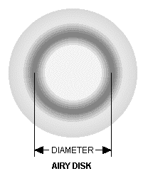
Definitions
Operating Parameters
Power – is the time rate at which energy emitted, transferred, or received (Watts or joules/second)
Spot Size - describes the diameter of the minimum spot achievable
Exposure Time - generally given is seconds but also occasionally in milliseconds
Power Density - The amount of power concentrated onto a spot (W/cm²)

Slide 21
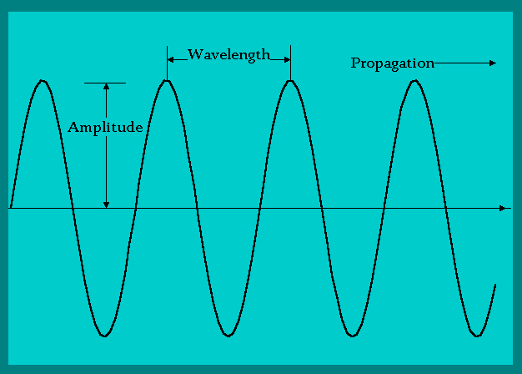
Lasers Physics
Wave Components
Amplitude - the height of the wave
Wavelength(λ) - the distance from one wave top to the next
Frequency - the number of waves passed per time interval

Slide 22
Lasers
Lasers are described by the wavelength of the electromagnetic spectrum, the temporal (time)
properties of the beam
Infrared
Visible Spectrum
Ultraviolet
The length of time the beam is active:
Continuous Wave (CW)
Pulsed
Ultra-short Pulsed

Slide 23
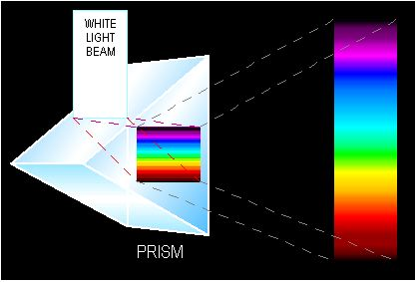
Lasers Physics
Characteristics of Light
Visible Light: The small region or range of the electromagnetic spectrum
White light: spectrum of wavelengths (color dispersion)
Monochromatic: single wavelength
Electromagnetic: wave that stimulates our retina
Dispersion: separation of visible light into its different colors (wavelength)

Slide 24
Lasers Physics
Light Interaction
Objects tend to selectively absorb, reflect, or transmit light of certain frequencies
Absorption -energy is converted to heat(e⁻@ground state is raised to an excited state
Reflection -those wavelengths not absorbed or transmitted
Transmitted -transparent objects

Slide 25
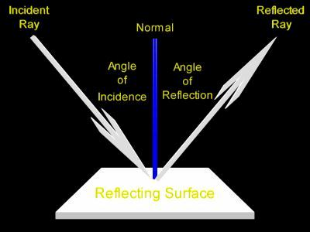
Lasers Physics
Light Interaction (Reflection)
Angle of incidence: angle between the light ray striking the medium and the normal line to the medium
Angle of reflection: angle between the light ray reflected and the normal line to the medium
[Percentage of light bounces back into the medium of origin]

Slide 26
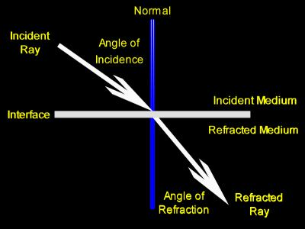
Lasers Physics
Light Interaction (Transmitted)
Angle of refraction: angle between the light ray refracted and a normal line to the medium
Refractive index: ratio of the speed of light in free space divided by the speed within the material
ex. Index Values
free space = 1, air = 1.0002, water = 1.333, diamond = 2.417

Slide 27
Basic Laser Safety - Bio effects
Bio effects
Primary sites of damage
  eyes
  Skin
Laser damage can be:
  Thermal-
  Acoustic
  Photochemical

Slide 28
Bio effects
Photo thermal effects- radiation absorbed by the tissue increase the tissue’s temperature until a laser burn or damage occurs. Directly related to power. Rate-process, Heat dissipation with time, thermal damage is not cumulative, as long as the retina cools down between exposures.
Most cell survives temperature high as 113 degrees, cells begin to die at 140 degrees.
Photochemical effects- depends on the total amount of energy
absorbed by the tissue, rather than the rate at which it is absorbed.
Individual photon interacts with molecule, damage is severe at shorter
visible wavelengths (blue &violet) and is cumulative over a working day
Photo acoustical effects are energy dependent, associated with ultra short pulse durations (<10 microsec) of high energy that cause rapid expansion of the tissue on which they are incident. From exposure to high energy pulsed lasers results in physical tissue damage by photon energy
This generates an acoustic shock wave in the tissue that may cause
a mechanical disruption of cellular structures.

Slide 29
Laser Effects on Biological Tissue
Bio effects
Damaging interaction or effects
Scattering (blood,lymph,skin)
Coefficient of Absorption
(highest at increased water content)
Transmission (cornea, lens, aqueous humor)
Temperature (dependent on water content)

Slide 30
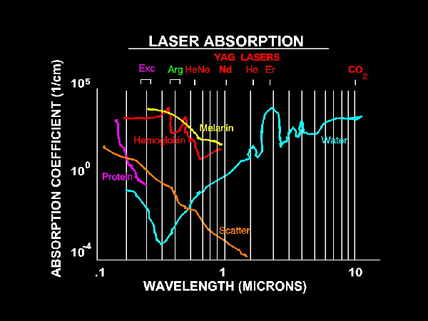
Coefficient of Absorption & Selective Absorption
Bio effects

Slide 31
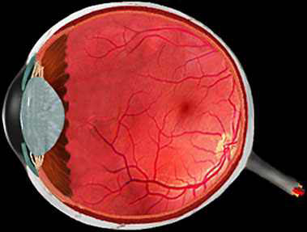
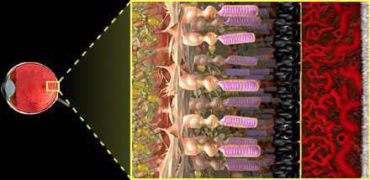
Anatomy of the Eye
Eye
Retinal pigment epithelium
(RPE)
retina
iris
vitreous
choroid
Optic nerve
Photoreceptor layer
choroid
cornea
lens
sclera

Slide 32
EYE HAZARDS
Eye
Light (radiation) enters the eye through the cornea, passes through the pupil, opening the iris, focused on the retina by the lens.
Effective eye focal length of 17 mm. Diameter of pupil can be small as 2mm and large as 7mm.
Light enter the eyes in several directions. Image is formed over entire retina. Power density of light incident on the retina is relatively low.
Typical Pupil Sizes
2 mm Daylight
3 mm Indoor
7 mm Dark Adapted
8 mm Dilated (for eye exam)
However, a collimated beam incident on the lens is focused onto a small spot 20 micrometers on the retina. The resultant increase in power density is on the order 10⁵ on the retina.

Slide 33
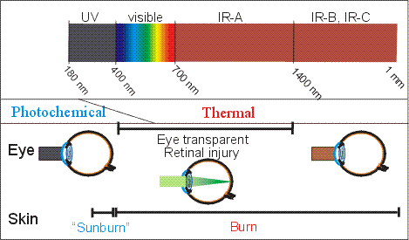
Hazards to the Eye
Eye
Ocular Absorption
cornea <300nm , > 3000nm
(corneal opacity) UV
lens 300-400, 1400-3000nm
(cataract) 400-1400nm
(Optical gain is 100,000; 1mW at lens is = 100W @ retina;
(7 mm diameter pupil size)

Slide 34
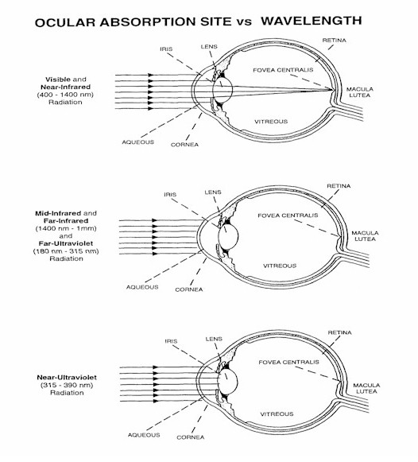

Slide 35
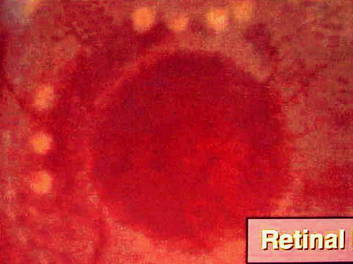
4
8
5
6
7
3
2
1
Each number represents a laser hit to the vitreous and in close proximity to the retina

Slide 36
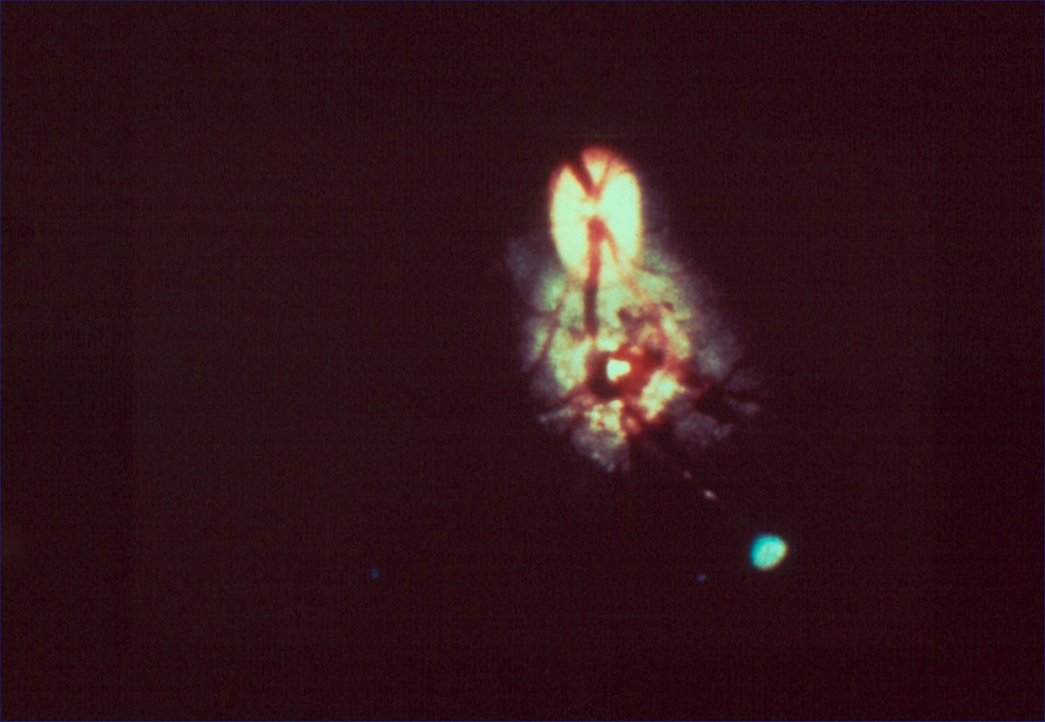
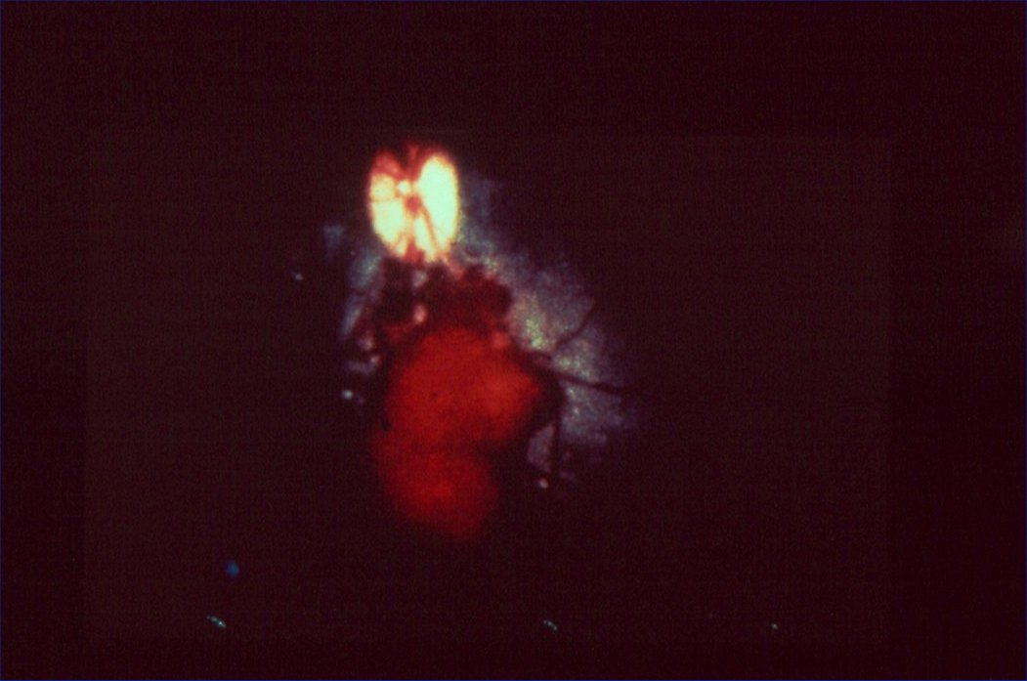
Eye Burn
Eye
Argon laser burn
The damage occurs on the retina

Slide 37
Laser Hazards - Monochromaticity
Eye Protection
Only use laser eye protection specifically labeled for the type of laser used
Just because it is the right color does not mean it will stop the laser.
OD and wavelength is usually written on side of goggles
Use viewing devices

Slide 38
Laser Operation and Eye Exposure
Eye Safety
Always think before doing, when aligning laser/optical systems
Follow the SOP and beam alignment procedures (class 3B and 4)
KEEP THE LIGHTS ON
Smaller iris lets-through less light, focus is larger
Don’t do involved alignment in an overly-fatigued state
Beam block when inserting new optical elements
EXTRA CARE: Cells, Vacuum chambers, Lens surface reflections, Color filters can tilt upward

Slide 39
EYE SAFETY
Eye Safety
Avoid “eye level” beams
Avoid situations where the beam is, or might be deflected upward
i.e. beam steering, “flippers,” periscopes
Use beam blocks
Residual unreflected light from dielectric mirrors
If necessary, fully enclose so that there is no chance of passing
through beam
Exercise caution when leaning down to beam-level
Always look away from table area when bending-down
Think twice before leaning to table level to get a better look at your experiment
Be VERY CAUTIOUS using “IR cards” and Ultraviolet (UV) Sensor Cards

Slide 40
Skin Photochemical and Thermal Burns
Skin burns
Ultraviolet (UV)
–UV can cause skin injuries comparable to a sun burn
  As with damage from the sun, there is an increased risk for developing skin cancer from UV laser exposure.
Thermal Injuries
High powered (Class 4) lasers, can burn the skin and even from the infrared (IR) and visible range cause first, second, and third degree of sun burns and set clothes on fire.

Slide 41
Photochemical and Thermal Burns
Skin burns
Thermal Skin Burns-Rare; normally requires high exposure dose of at least several J/cm2; most common from CO2,10.6 μm exposure.
First degree (erythema), second degree (blistering), and third degree (charring) burns are possible-dependent upon exposure dose.

Slide 42
Basic Laser Safety - Exposure Limits
Exposure Defined
MPE (Maximum Permissible Exposure)
  The highest laser energy exposure for eye or skin for a given laser that will not cause injury
NHZ (Nominal Hazard Zone)
  Area within which the MPE can be met or exceeded

Slide 43
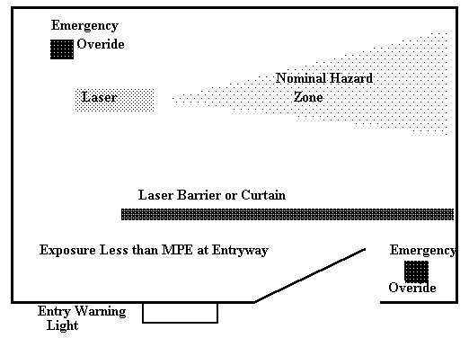

Slide 44
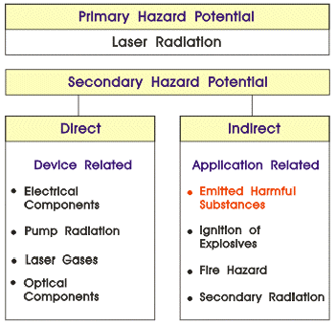
Hazards
Associated Potential Hazards
Recognize hazard potential to eliminate potential disasters:
Blindness
Burns
Fire
Death

Slide 45
Controls
Control Measures
Administrative and Procedural: organizational and procedural aspects of laser safety
Examples
Standard Operating Procedures (SOP)
Training
Credentialing requirements
Procurement and Registration of HCLS
Incident reports
Inspections
Identify the NHZ
Servicing

Slide 46
Basic Laser Safety - Safety Controls
Administrative
Administrative Controls
  Warning Signs
  Labels
  SOPs- Class 3B and 4 laser systems
  Training
  Security

Slide 47
Basic Laser Safety - Safety Controls
Engineering
Engineering Controls
  Beam Housings
  Shutters
  Attenuators
  Remote viewing devices
  Interlocks/switch lock receptacles
  Emergency Disconnects

Slide 48
Non -Beam Hazard
Electrical Hazards-Non Beam Hazards
Inspect cords, cables, and plugs
Improperly insulated electrical terminals
Excessive wires and cables on floor (trip hazard)
Equipment inspection certification

Slide 49
Non -Beam Hazard
Basic Laser Safety - Non-Beam Hazards
Chemical
  Dye lasers
  Gases from laser operations
Optical
  UV from laser welding
  UV from discharge tubes and pumping
Fire/Explosion
  Ignition of gases and/or vapors
  Electrical Wiring and Capacitor banks

Slide 50
Non-beam hazard
LGAC-Laser Gas Air Contaminates
Laser plume may contain bacteria spores, carcinogens, fine
dust mutagen, irritants, metal oxides, viruses and cancer
cells
Effective Controls
Safe work practice (filtration mask)
Ventilation system
-high efficiency particulate air (HEPA) filters
-exhaust air outside
Are you working with Biological and/or Chemical's with your laser system? If, so contact LSO

Slide 51
Fire Precaution
Fire
Use wet or fire retardant materials in the operative room or
research labs
Non- combustible materials or chemicals only
Properly drape or cover adjacent tissue site from laser radiation
Control liquefied fat by suction to minimize potential for flash fire
Prepare the operative room with water during laser procedures
Recognize the location of the nearest fire extinguisher in the operative room
Develop awareness and response operating procedure

Slide 52
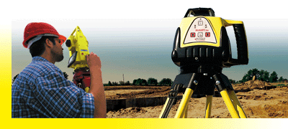
Alignment
Beam Alignments
The majority of accidents occur during beam alignments
Required Beam alignment procedures for all class
3B & 4 laser system are submitted to LSO and LSSC

Slide 53

Lockout/Tag out Procedures
DEFECTIVE
DO NOT USE
Date ___________
By ___________
Do not Remove
This Label
Laser systems that have
Safety concerns.
Ensures that the equipment
being controlled cannot be re-
energized until the locking
device is removed

Slide 54
Basic Laser Safety - LSO
LSO
Laser Safety Officer (LSO)
ANSI Z136.1 specifies that any facility using Class 3B or Class 4 lasers or laser systems should designate a Laser Safety Officer to oversee safety for all operational, maintenance, and servicing situations.
This person should have the authority and responsibility to monitor and enforce the control of laser hazards. This person is also responsible for the evaluation of laser hazards and the establishment of appropriate control measures.

Slide 55
Operational
Elements of BU Laser Safety Program
Laser Safety Committee/LSO
Equipment Registration-Class 3B and 4
Personnel Registration and Training
SOPs- (3B and 4)
Signage
Emergency Procedures
Inspections and Monitoring

Slide 56
Operational
Elements of BU Laser Safety Program
Laser Supervisor’s Role
  Train users
  Write SOPs
  Beam Alignment
  Post emergency numbers and procedures
  Allow only authorized users to enter hazard areas
  Address non-beam hazards

Slide 57
Operational
Elements of BU Laser Safety Program
Laser User’s Role
  Follow SOP
  Wear appropriate eyewear
  Use minimum power required/reduce output with attenuators
  Keep beam path away from eye level
  Remove unnecessary objects from table

Slide 58
Laser Safety Regulations
LSO
Occupational Safety & Health Administration (OSHA)
No specific laser safety regulations, but will cite safety issues under the General Duty Clause 29 CFR 1910.132 & 133 and will enforce the ANSI standards for laser safety.
American National Standards Institute (ANSI)
ANSI- Z 136.1
ANSI-Z 136.3
MA-DPH 120 CMR 105

Slide 59

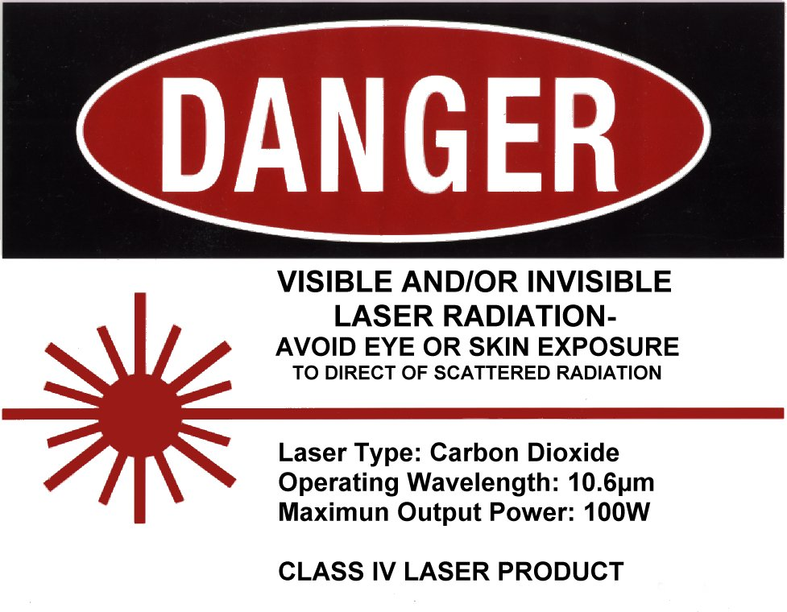
Door Posting Requirements
NHZ egress

Slide 60
Laser Safety
Basic Laser Safety - Accidents
Common Causes of Accidents
  Accidental energization or firing of laser
  Bypass of Interlocks
  Beam Alignment
  Grounding
  No goggles
  Movement of beam path
  Reflective objects in beam path (clutter)
CALL 617-638-7052 (BUMC)
24 hrs.
617-353-7233 (CRC)

Slide 61
Operational
Optical protection: practical tips for laser operators
REMOVE jewelry, especially watches and rings to avoid reflection and other reflective material from your body
Most incidents occur during alignment •Avoid using reflective tools in alignment
Monitor all reflection from optics in the setup
Close eyes when bowing through plane of laser table–i.e. picking up a dropped tool
Communicate with other lab operators, when performing high‐risk tasks
Wear laser safety glasses or goggles when appropriates

Slide 62
Basic Laser Safety - Exercise
Can you identify safe and/or unsafe conditions?

Slide 63
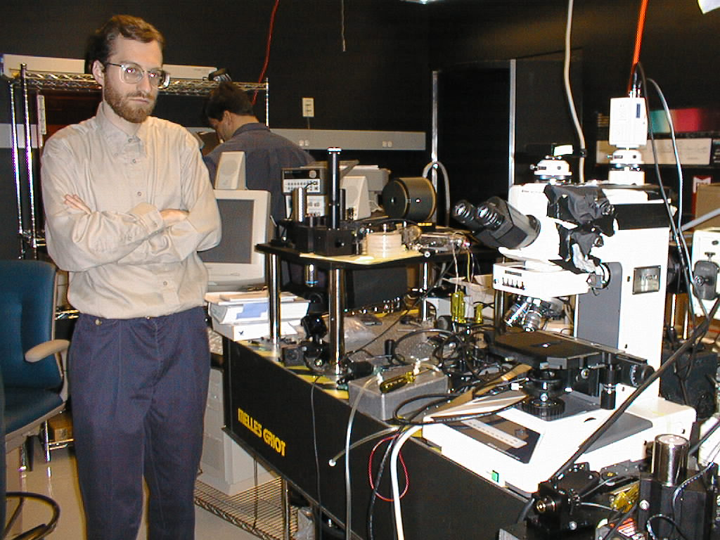

Slide 64
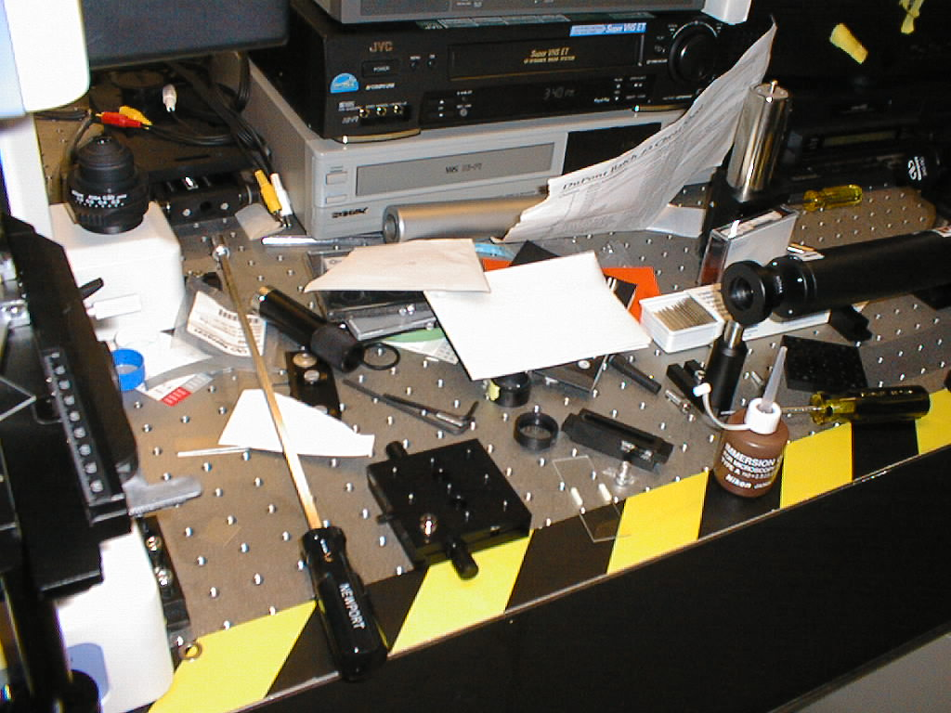

Slide 65
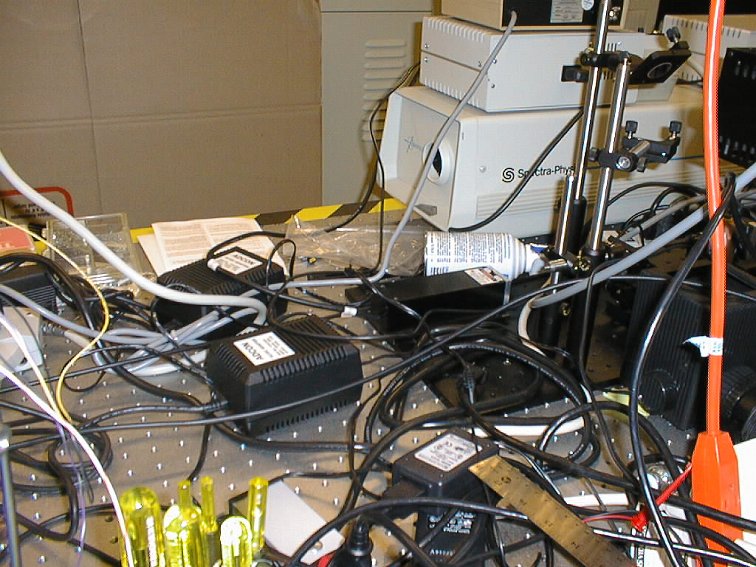

Slide 66
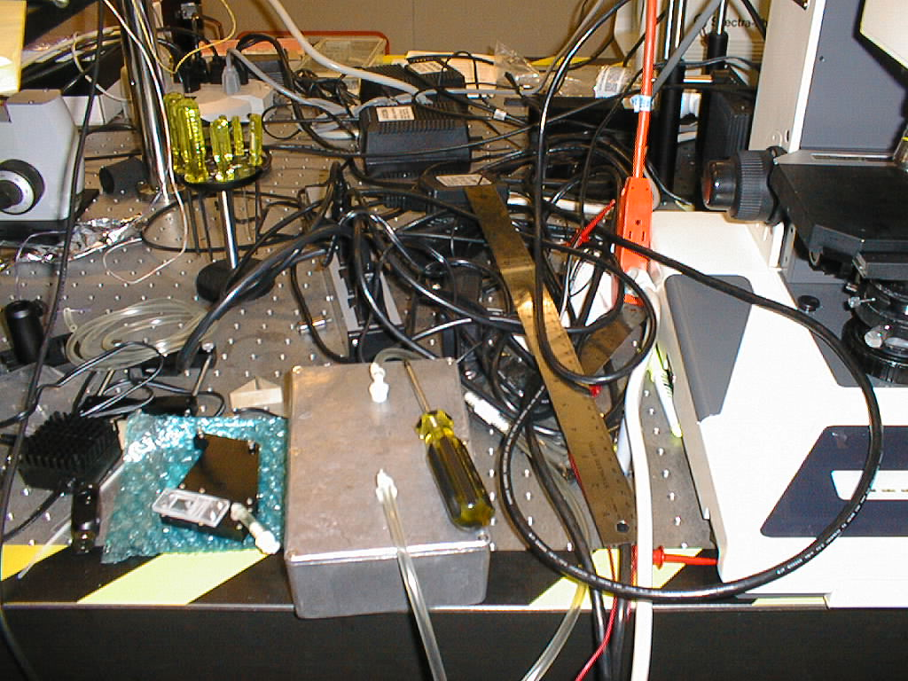

Slide 67
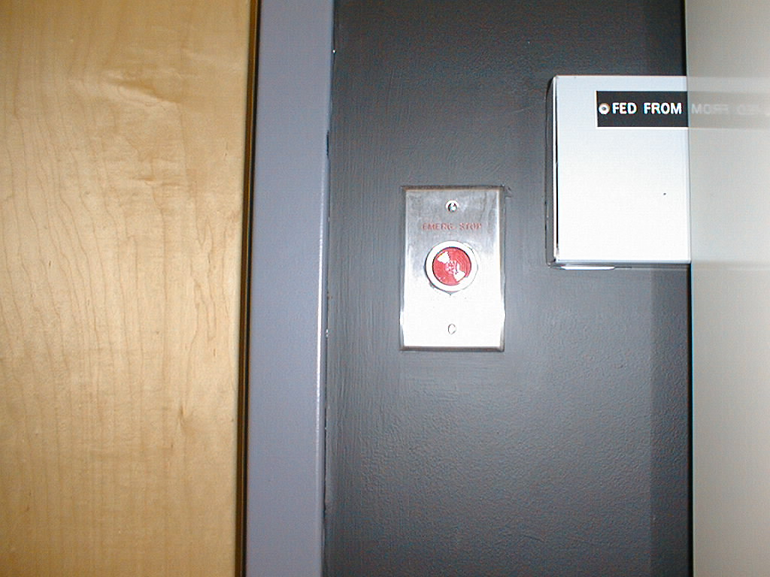
Emergency
Power Off

Slide 68
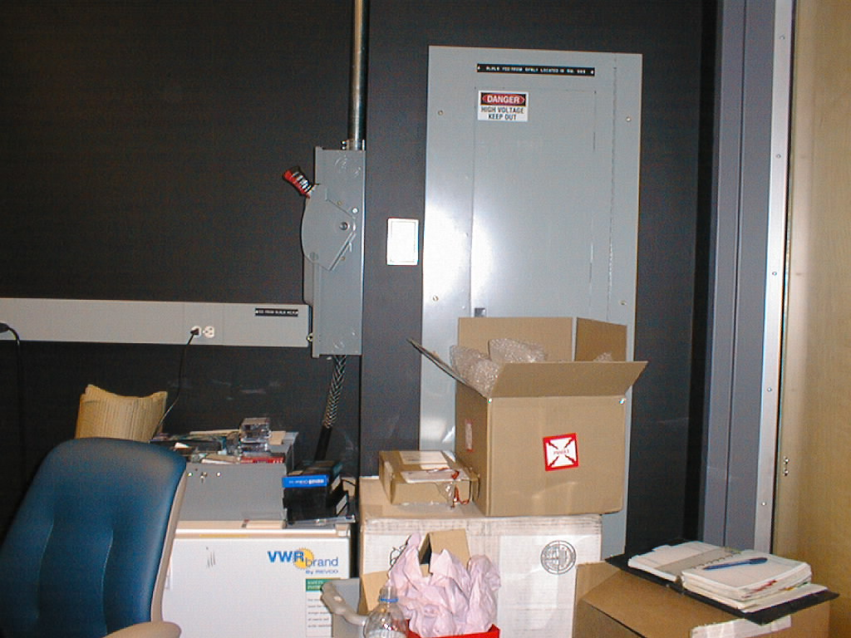
Emergency
Power Off

Slide 69
Important Information
BU Laser Safety Officer
  617-638-7052 Medical Campus
  617-353-7233 CRC
MA DPH Radiation Control Program
  105 CMR 121.000 Regulations for the Control of Lasers
ANSI Z-136 Series (Z136.1 and Z136.5)
24 hr. Contact, CONTROL CENTER 617-638-4144 (BUMC)
24 hr. Contact 617-353-SAFE (CRC)

Slide 70
Summary
All Class 3B and 4 laser systems must be registered with the LSO
All Class 3B and 4 laser systems users must have SOP’s, alignment procedures, user registration, user certifications,
eye-ware and safety devices.
See our web site for all forms at:
http://www.bu.edu/ehs/plans/management-plans/laser-safety/
Notify the LSO of all new laser purchases, intended disposal, or transfers of laser systems.

Slide 71
QUIZ
This training presentation meets ANSI standards.
Additional laser training is provided by your permit holder on specific laser systems.
If you have any questions, contact the Laser Safety Officer at 617-638-7052.
A passing grade of 70 percent is required.

